Slide 1
Lake Area Radio Klub Balun Construction Project
Dave LeVasseur, N0DL Gary “Joe” Mayfield, KK0SD
March 17, 2021
Lake Area Radio Klub PO Box 642
Watertown, SD 57201
www.w0wtn.org

Slide 2
The following photos were taken in the approximate order of construction of the balun. This is not intended to be a step-by-step guide to building the balun but should give anyone familiar with project construction enough details to assemble a balun well enough that it should last for many years.

Slide 3
Winding the core
4T of RG-58X Coax, approximately 2’ total

Slide 4
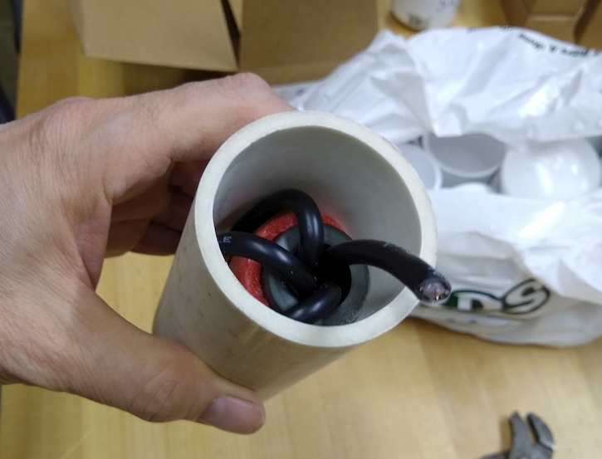
Assembling the wound balun into the PVC Pipe

Slide 5
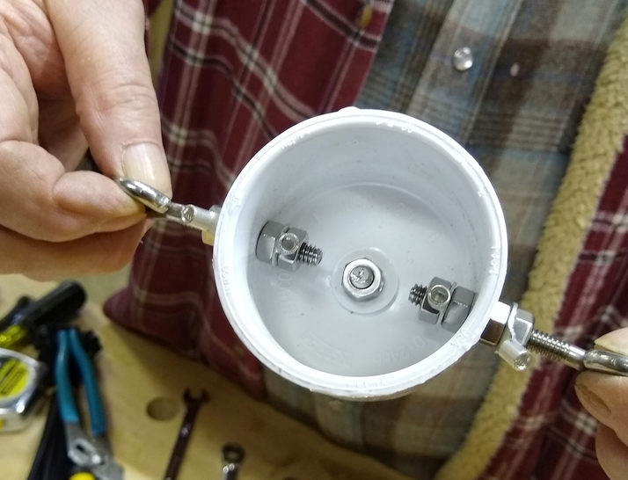
Assembling the top cap with eye bolts and solder lugs

Slide 6
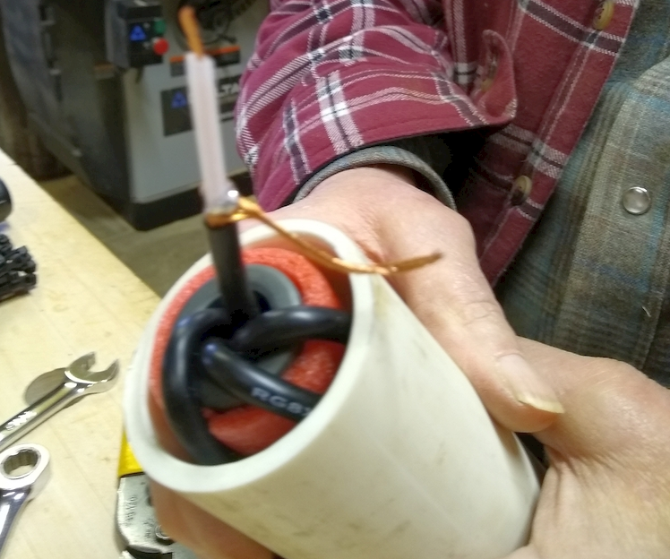
Top end showing RG-8X stripped

Slide 7
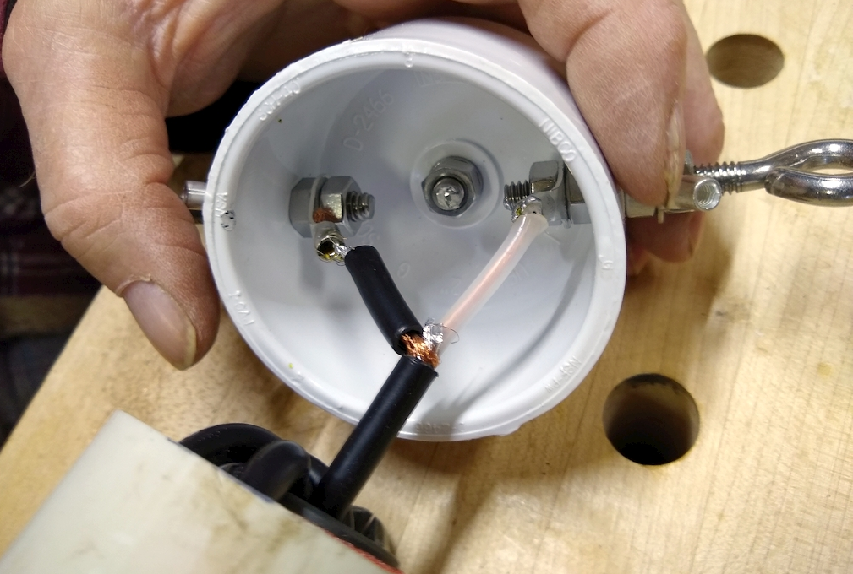
RG-8X soldered into top cap, excess coax sheath used to insulated the shield connection

Slide 8
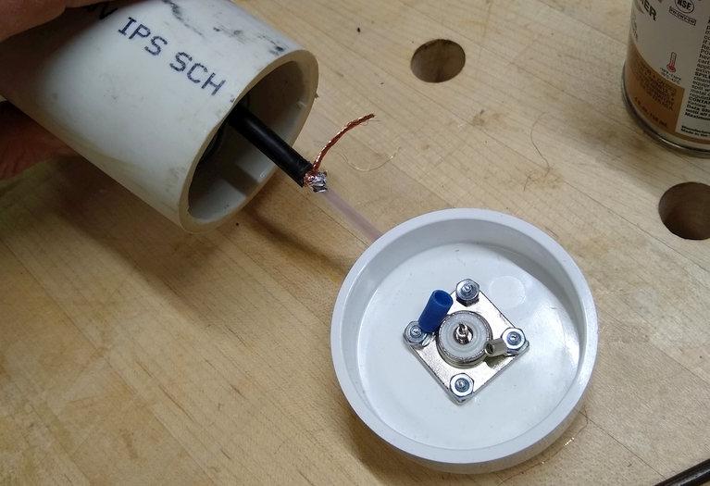
Preparing the bottom end and cap for soldering

Slide 9
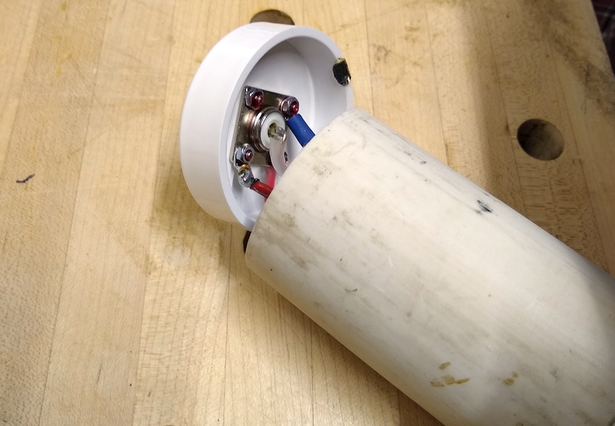
Bottom cap soldered and positioned for assembly (this balun’s ground leads were divided and soldered separately - optional) Thread-locking adhesive applied to bolt threads for added reliability

Slide 10
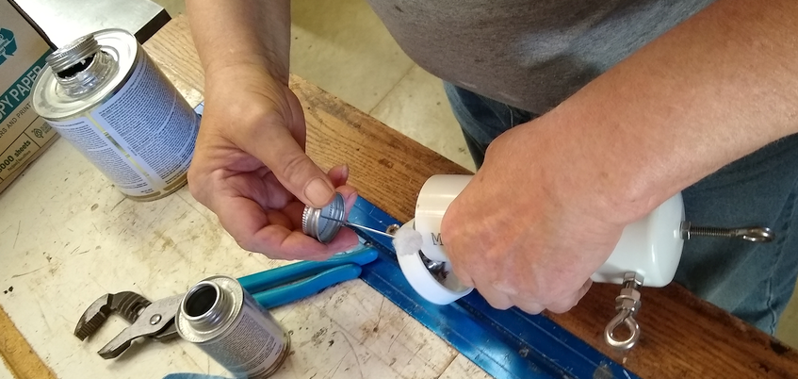
All PVC-PVC connections were cleaned, primed and secured with PVC cement

Slide 11
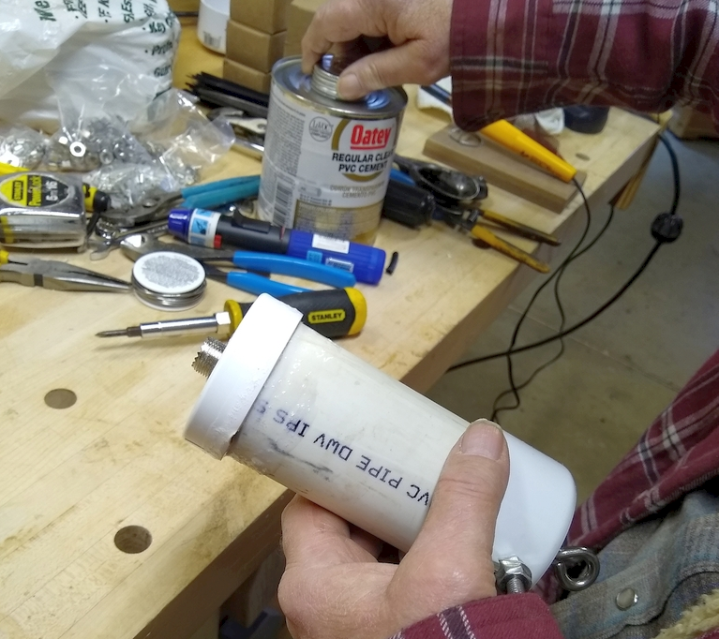
All PVC-PVC connections were cleaned, primed and secured with PVC cement

Slide 12
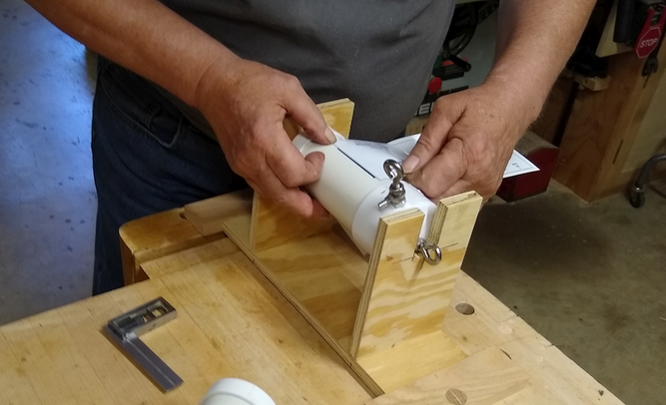
A fixture helped with the application of the labels

Slide 13
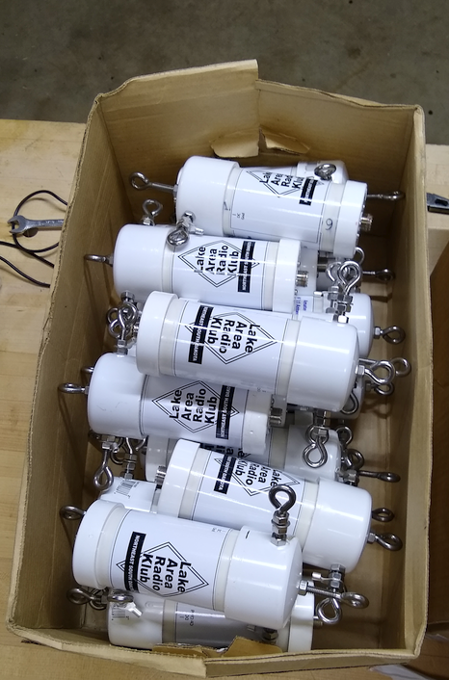
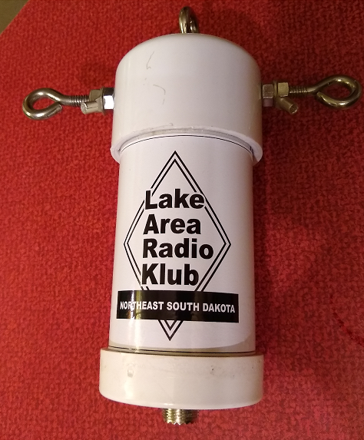
The completed balun

