Slide 1
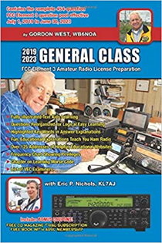
General Licensing Class
Your Passing CSCE
Valid July 1, 2019
Through
June 30, 2023
Notes:
1

Slide 2
Amateur Radio General Class Element 3 Course Presentation
ELEMENT 3 SUB-ELEMENTS (Groupings)
1 - Your Passing CSCE
2 - Your New General Bands
2 - FCC Rules
4 - Be a VE
5 - Voice Operations
6 - CW Lives
7 - Digital Operating
8 - In An Emergency
9 - Skywave Excitement

Slide 3
Amateur Radio General Class Element 3 Course Presentation
ELEMENT 3 SUB-ELEMENTS (Groupings)
10 - Your HF Transmitter
11 - Your Receiver
12 - Oscillators & Components
13 - Electrical Principles
14 - Circuits
15 - Good Grounds
16 - HF Antennas
17 - Coax Cable
18 - RF & Electrical Safety

Slide 4
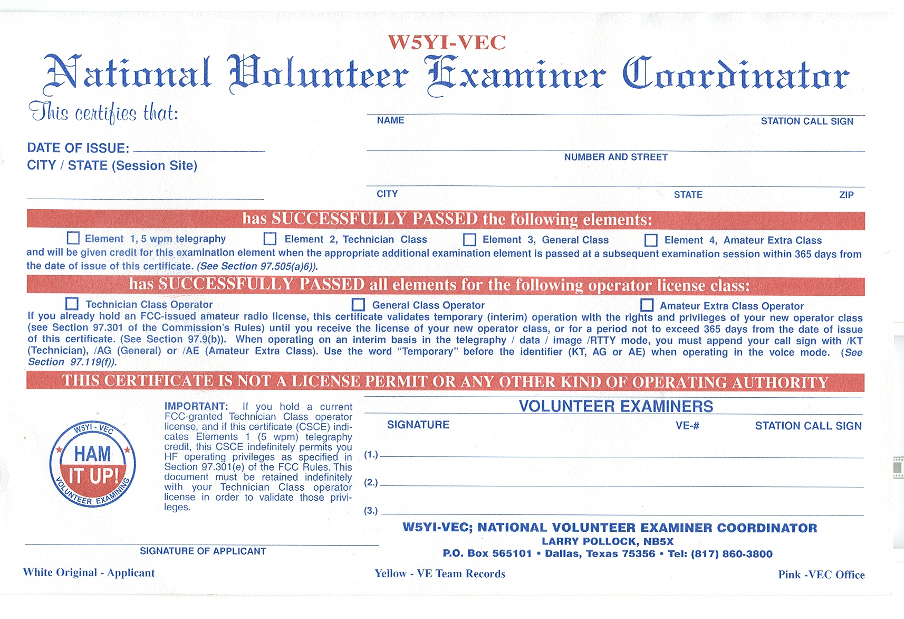
Your Passing CSCE
A Certificate of Successful Completion of Examination (CSCE) is valid for exam element credit for a period of 365 days. (G1D09)

Slide 5
Your Passing CSCE
You must add the special identifier "AG" after your call sign if you are a Technician Class licensee and have a CSCE for General Class operator privileges, but the FCC has not yet posted your upgrade on its web site whenever you operate using General Class frequency privileges. (G1D06)
Any person who can demonstrate that they once held an FCC issued General, Advanced, or Amateur Extra class license that was not revoked by the FCC, may receive credit for the elements represented by an expired amateur radio license. (G1D01)

Slide 6
Your Passing CSCE
If you are a Technician Class operator and have a CSCE for General Class privileges you may operate on any General or Technician Class band segment. (G1D03)
A person with an expired FCC issued amateur radio license of General Class or higher, can receive a new license after passing the current element 2 exam. (G1D11)

Slide 7
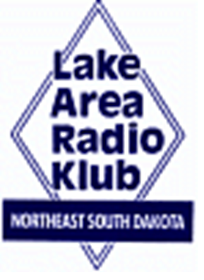
Element 3 General Class Question Pool
Your Passing CSCE
Valid July 1, 2019
Through
June 30, 2023

Slide 8
G1D09 How long is a Certificate of Successful Completion of Examination (CSCE) valid for exam element credit?
30 days
180 days
365 days
For as long as your current license is valid

Slide 9
G1D06 When must you add the special identifier "AG" after your call sign if you are a Technician Class licensee and have a CSCE for General Class operator privileges?
Whenever you operate using General class frequency privileges
Whenever you operate on any amateur frequency
Whenever you operate using Technician frequency privileges
A special identifier is not required as long as your General class license application has been filed with the FCC

Slide 10
G1D01 Who may receive credit for the elements represented by an expired amateur radio license?
Any person who can demonstrate that they once held an FCC issued General, Advanced, or Amateur Extra class license that was not revoked by the FCC
Anyone who held an FCC issued amateur radio license that has been expired for not less than 5 years and not more than 15 years
Any person who previously held an amateur license issued by another country, but only if that country has a current reciprocal licensing agreement with the FCC
Only persons who once held an FCC issued Novice, Technician, or Technician Plus license

Slide 11
G1D03 Which of the following band segments may you operate on if you are a Technician Class operator and have a CSCE for General Class privileges?
Only the Technician band segments until your upgrade is posted on the FCC database
Only on the Technician band segments until your license arrives in the mail
On any General or Technician class band segment
On any General Class Band segment except 30 and 60 meters

Slide 12
G1D11 If a person has an expired FCC issued amateur radio license of General Class or higher, what is required before they can receive a new license?
They must have a letter from the FCC showing they once held an amateur or commercial license
There are no requirements other than being able to show a copy of the expired license
The applicant must be able to produce a copy of a page from a call book published in the USA showing his or her name and address
The applicant must pass the current element 2 exam

