Slide 1

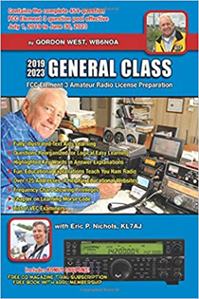
General Licensing Class
Oscillators & Components
Valid July 1, 2019
Through
June 30, 2023
Notes:
1

Slide 2
Amateur Radio General Class
Element 3 Course Presentation
ELEMENT 3 SUB-ELEMENTS (Groupings)
  1 - Your Passing CSCE
  2 - Your New General Bands
  3 - FCC Rules
  4 - Be a VE
  5 - Voice Operations
  6 - CW Lives
  7 - Digital Operating
  8 - In An Emergency
  9 - Skywave Excitement

Slide 3
Amateur Radio General Class
Element 3 Course Presentation
ELEMENT 3 SUB-ELEMENTS (Groupings)
  10 - Your HF Transmitter
  11 - Your Receiver
  12 - Oscillators & Components
  13 - Electrical Principles
  14 - Circuits
  15 - Good Grounds
  16 - HF Antennas
  17 - Coax Cable
  18 - RF & Electrical Safety

Slide 4
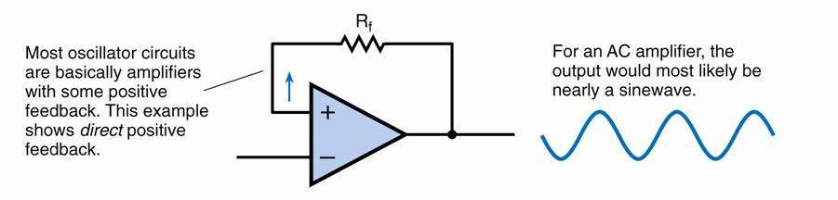
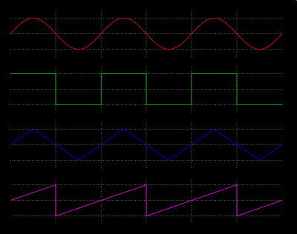
Oscillators & Components
The basic components of virtually all sine wave oscillators are a filter and an amplifier operating in a feedback loop. (G7B07)
Sine wave
Square wave
Triangle wave
Sawtooth wave
Voltage waveforms

Slide 5
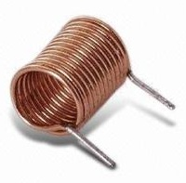
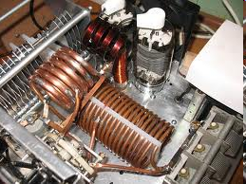
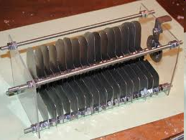
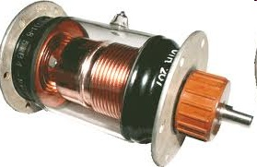
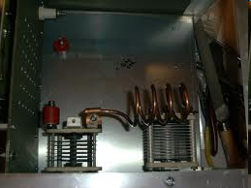
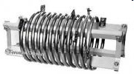
Oscillators & Components
The inductance and capacitance in the tank circuit determines the frequency of an LC oscillator. (G7B09)
Inductors
(variable) Capacitors
Tank Circuits

Slide 6
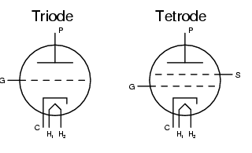
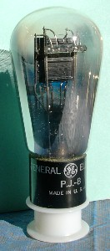
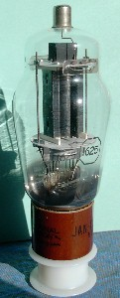
Oscillators & Components
The control grid is the element of a triode vacuum tube is used to regulate the flow of electrons between cathode and plate. (G6A10)
The primary purpose of a screen grid in a vacuum tube is to reduce grid-to-plate capacitance. (G6A12)
H=Heater/Filament; C=Cathode; S=Screen Grid; P=Plate

Slide 7
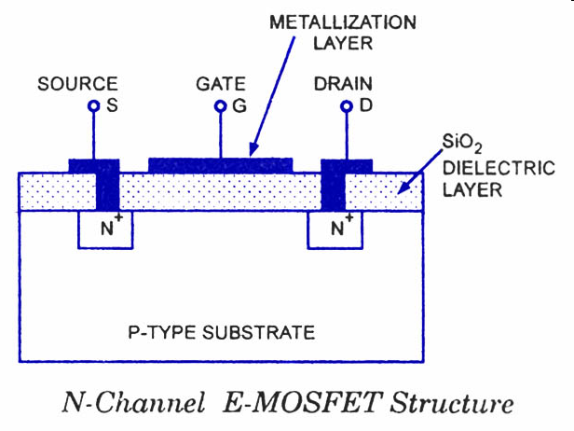
Oscillators & Components
The stable operating points for a bipolar transistor used as a switch in a logic circuit are its saturation and cut-off regions. (G6A07)
    Saturation is where the transistor is Base biased for maximum emitter to collector current flow
    Cut-off is where the transistor is base biased for minimum emitter to collector current flow
In a MOSFET, the gate is separated from the channel with a thin insulating layer. (G6A09)

Slide 8
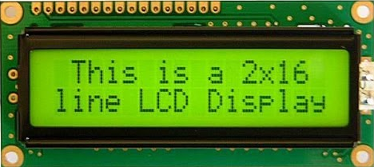
Oscillators & Components
The approximate junction threshold voltage of a germanium diode is 0.3 volts. (G6A03)
    This is the voltage drop across the diode junction when it is conducting in the forward direction.
The approximate junction threshold voltage of a silicon diode is 0.7 volts. (G6A05)
    This is the voltage drop across the diode junction when it is conducting in the forward direction
an LED is forward biased when emitting light (G6B08)
    LEDs generate very little heat leading to greater efficiency.
A liquid crystal display (LCD) utilizes ambient or back lighting(G6B09)

Slide 9
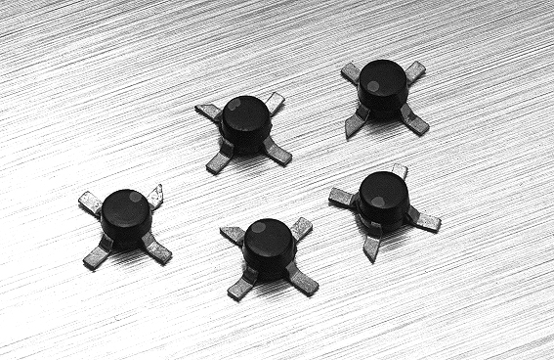
Oscillators & Components
The term MMIC means Monolithic Microwave Integrated Circuit. (G6B02)
Analog is also the term that describes an integrated circuit operational amplifier. (G6B06)
MMIC devices
Signal connections
Schematic symbol
Integrated circuit

Slide 10
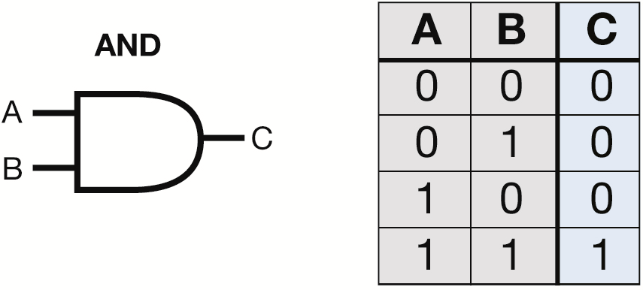
Oscillators & Components
For a two input AND gate, the output is high only when both inputs are high. (G7B03)
Truth table for AND Gate

Slide 11
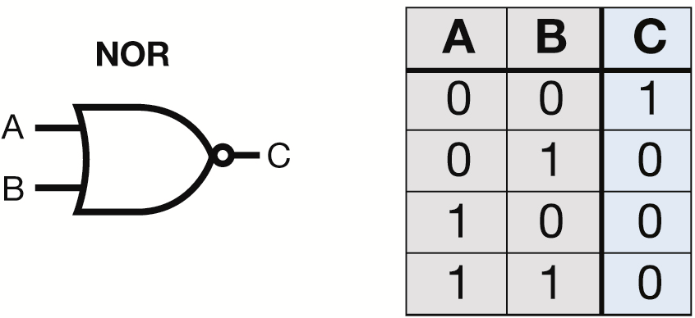
Oscillators & Components
For a two input NOR gate, the output is low when either or both inputs are high. (G7B04)
Truth table for NOR Gate

Slide 12
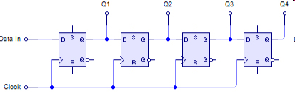
Oscillators & Components
Integrated circuits that provide more complex logic functions, such as counters and shift registers, are also available. A 3-bit binary counter has 8 states. (G7B05)
    There are 8 states in a 3-bit binary counter.
        000 001 010 011
        100 101 110 111
A shift register is a clocked array of circuits that passes data in steps along the array. (G7B06)
4-Bit SIPO Shift Register

Slide 13
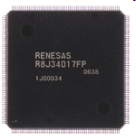
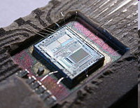
Oscillators & Components
Low power consumption is an advantage of CMOS integrated circuits compared to TTL integrated circuits. (G6B03)
    CMOS is the most commonly used digital logic family of integrated circuits.
The term ROM means Read Only Memory. (G6B04)
Memory characterized as “non-volatile,” means the stored information is maintained even if power is removed. (G6B05)
LSI Devices
DVD Recorder
Intel 8742

Slide 14
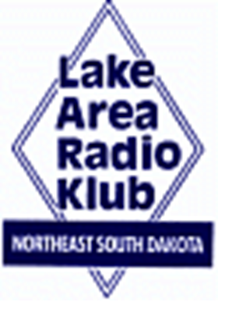

Element 3 General Class Question Pool
Oscillators & Components
Valid July 1, 2019
Through
June 30, 2023

Slide 15
G7B07 What are the basic components of virtually all sine wave oscillators?
An amplifier and a divider
A frequency multiplier and a mixer
A circulator and a filter operating in a feedback loop
A filter and an amplifier operating in a feedback loop

Slide 16
G7B09 What determines the frequency of an LC oscillator?
The number of stages in the counter
The number of stages in the divider
The inductance and capacitance in the tank circuit
The time delay of the lag circuit

Slide 17
G6A10 Which element of a triode vacuum tube is used to regulate the flow of electrons between cathode and plate?
Control grid
Heater
Screen Grid
Trigger electrode

Slide 18
G6A12 What is the primary purpose of a screen grid in a vacuum tube?
To reduce grid-to-plate capacitance
To increase efficiency
To increase the high frequency response
To decrease plate resistance

Slide 19
G6A07 What are the stable operating points for a bipolar transistor that is used as a switch in a logic circuit?
Its saturation and cut-off regions
Its active region (between the cut-off and saturation regions)
Between its peak and valley current points
Between its enhancement and deletion modes

Slide 20
G6A09 Which of the following describes the construction of a MOSFET?
The gate is formed by a back-biased junction
The gate is separated from the channel with a thin insulating layer
The source is separated from the drain by a thin insulating layer
The source is formed by depositing metal on silicon

Slide 21
G6A03 What is the approximate junction threshold voltage of a germanium diode?
0.1 volt
0.3 volts
0.7 volts
1.0 volts

Slide 22
G6A05 What is the approximate junction threshold voltage of a conventional silicon diode?
0.1 volt
0.3 volts
0.7 volts
1.0 volts

Slide 23
G6B08 How is an LED biased when emitting light?
Beyond cutoff
At the Zener voltage
Reverse Biased
Forward Biased

Slide 24
G6B09 Which of the following is a characteristic of a liquid crystal display?
It requires ambient or back lighting
It offers a wide dynamic range
It has a wide viewing angle
All of these choices are correct

Slide 25
G6B02 What is meant by the term MMIC?
Multi Megabyte Integrated Circuit.
Monolithic Microwave Integrated Circuit.
Military-specification Manufactured Integrated Circuit.
Mode Modulated Integrated Circuit.

Slide 26
G6B06 What kind of device is an integrated circuit operational amplifier?
Digital
MMIC
Programmable Logic
Analog

Slide 27
G7B06 What is a shift register?
A clocked array of circuits that passes data in steps along the array
An array of operational amplifiers used for tri-state arithmetic operations
A digital mixer
An analog mixer

Slide 28
G6B03 Which of the following is an advantage of CMOS integrated circuits compared to TTL integrated circuits?
Low power consumption
High power handling capability
Better suited for RF amplification
Better suited for power supply regulation

Slide 29
G6B04 What is meant by the term ROM?
Resistor Operated Memory
Read Only Memory
Random Operational Memory
Resistant to Overload Memory

Slide 30
G6B05 What is meant when memory is characterized as “non-volatile”?
It is resistant to radiation damage
It is resistant to high temperatures
The stored information is maintained even if power is removed
The stored information cannot be changed once written

Slide 31
G7B03 Which of the following describes the function of a two input AND gate?
Output is high when either or both inputs are low.
Output is high only when both inputs are high.
Output is low when either or both inputs are high.
Output is low only when both inputs are high.

Slide 32
G7B04 Which of the following describes the function of a two input NOR gate?
Output is high when either or both inputs are low.
Output is high only when both inputs are high.
Output is low when either or both inputs are high.
Output is low only when both inputs are high

Slide 33
G7B05 How many states does a 3-bit binary counter have?
3
6
8
16

