Slide 1


General Licensing Class
HF Antennas
Valid July 1, 2019
Through
June 30, 2023
Notes:
1

Slide 2
Amateur Radio General Class
Element 3 Course Presentation
ELEMENT 3 SUB-ELEMENTS (Groupings)
  1 - Your Passing CSCE
  2 - Your New General Bands
  3 - FCC Rules
  4 - Be a VE
  5 - Voice Operations
  6 - CW Lives
  7 - Digital Operating
  8 - In An Emergency
  9 - Skywave Excitement

Slide 3
Amateur Radio General Class
Element 3 Course Presentation
ELEMENT 3 SUB-ELEMENTS (Groupings)
  10 - Your HF Transmitter
  11 - Your Receiver
  12 - Oscillators & Components
  13 - Electrical Principles
  14 - Circuits
  15 - Good Grounds
  16 - HF Antennas
  17 - Coax Cable
  18 - RF & Electrical Safety

Slide 4
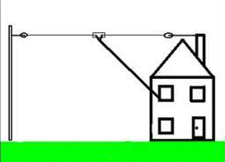
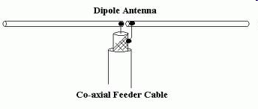
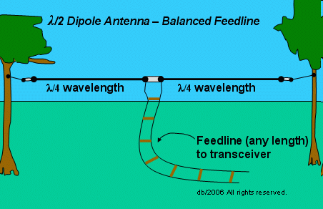
HF Antennas
33 feet is the approximate length for a 1/2-wave dipole antenna cut for 14.250 MHz. (G9B10)
    Calculate ½ wavelength in feet by dividing 468 by the frequency in MHz.
    468 / 14.250
    32.8 Feet
The approximate length for a 1/2-wave dipole antenna cut for 3.550 MHz is 132 feet. (G9B11)
    Calculate ½ wavelength in feet by dividing 468 by the frequency in MHz.
    468 / 3.550 or
    131.8 Feet
Half-wave Dipole with 450 ohm feedline (not coax).

Slide 5
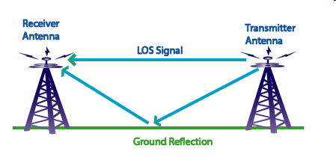
HF Antennas
An advantage of a horizontally polarized as compared to vertically polarized HF antenna is lower ground reflection losses. (G9B09)
  Propagation via multi-hop refraction:
    RF energy is lost each time the radio wave is reflected from the Earth's surface.
  The amount of energy lost depends on:
    Frequency of the wave
    Angle of incidence
    Ground irregularities
    Electrical conductivity of the point of reflection.
Near Vertical Incidence Skywave (NVIS) is short distance MF or HF propagation using high elevation angles (G3C10)
  Antennas used for DXing should have low takeoff angles.
  One thing that affects the takeoff angle of an antenna is its height above ground.

Slide 6
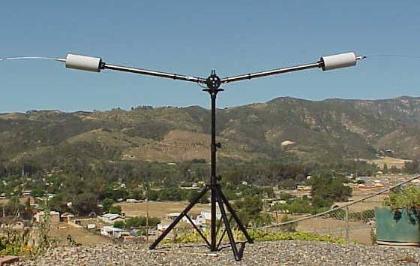
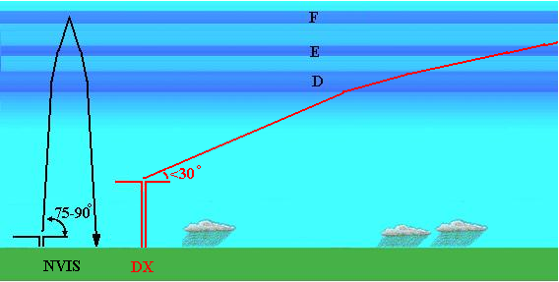
HF Antennas
A horizontal dipole between 1/10 and ¼ wavelength above the ground is an effective Near Vertical Incidence Skywave (NVIS) antenna. (G9D01)

Slide 7
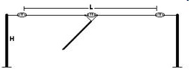
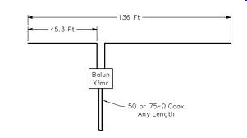
HF Antennas
As the antenna is lowered from 1/4 wave above ground, the feed-point impedance of a 1/2 wave dipole antenna steadily decreases. (G9B07)
  Antenna height affects the feed point impedance.
The feed-point impedance of a 1/2 wave dipole steadily increases as the feed-point location is moved from the center toward the ends. (G9B08)

Slide 8
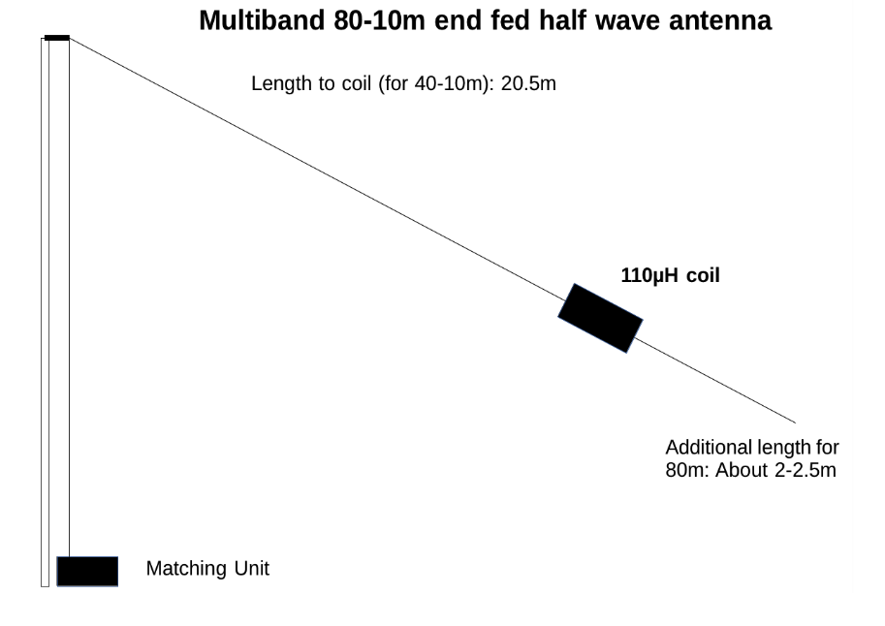
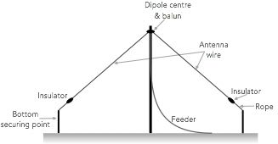
HF Antennas
An inverted V is the common name of a dipole with one center support (G9D12)
An end-fed half-wave antenna has a very high input impedance (G9D02)

Slide 9
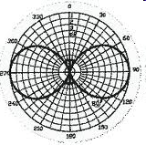
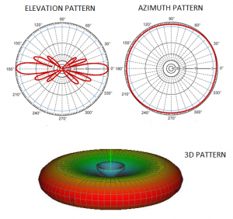
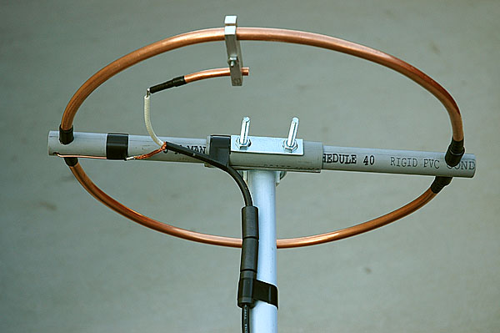
HF Antennas
The low angle azimuthal radiation pattern of an ideal half-wavelength dipole antenna installed 1/2 wavelength high and parallel to the Earth is a figure-eight at right angles to the antenna. (G9B04)
Maximum radiation from a “halo” antenna is omnidirectional in the plane of the antenna (G9D03)

Slide 10
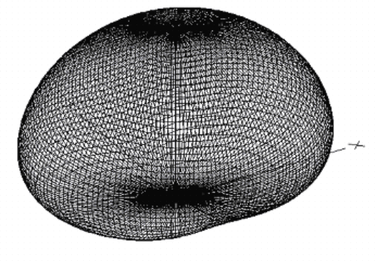
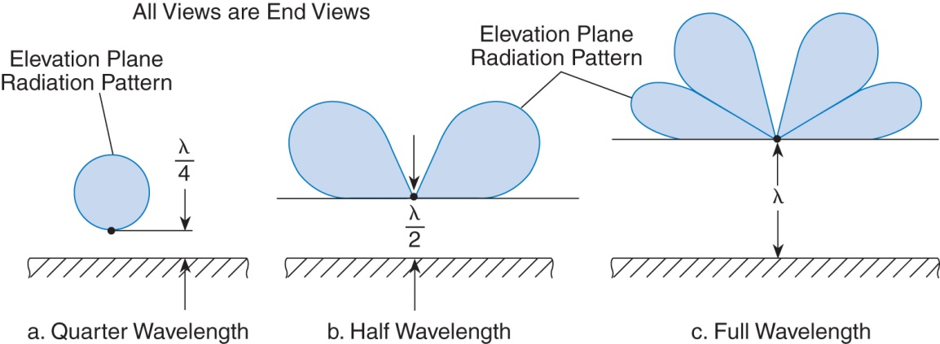
HF Antennas
If the antenna is less than 1/2 wavelength high, the azimuthal pattern is almost omnidirectional and maximum straight up. (G9B05)
Omni-directional pattern
Patterns change as height above ground is varied

Slide 11
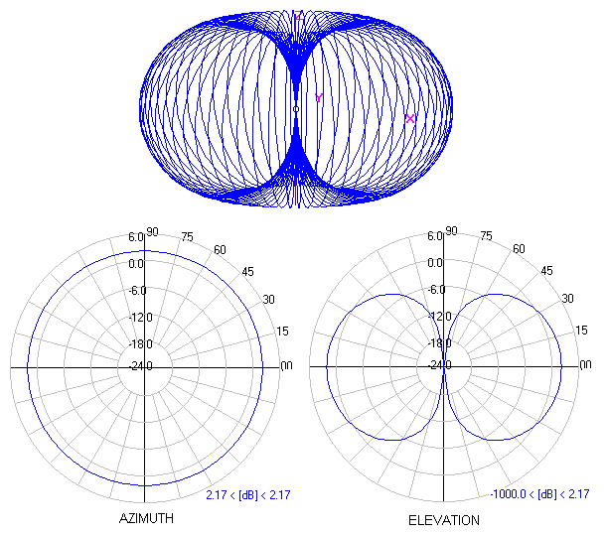
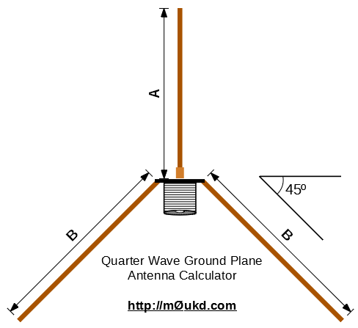
HF Antennas
A quarter-wave ground plane vertical has an omnidirectional radiation pattern (G9B03)
A quarter-wave vertical for 28.5 MHz is approximately 8 feet. (G9B12)
  28.5 MHz -> 10 Meters
  10 Meters / 4 = 2.5 Meters
  2.5 Meters = ~ 8 Feet

Slide 12
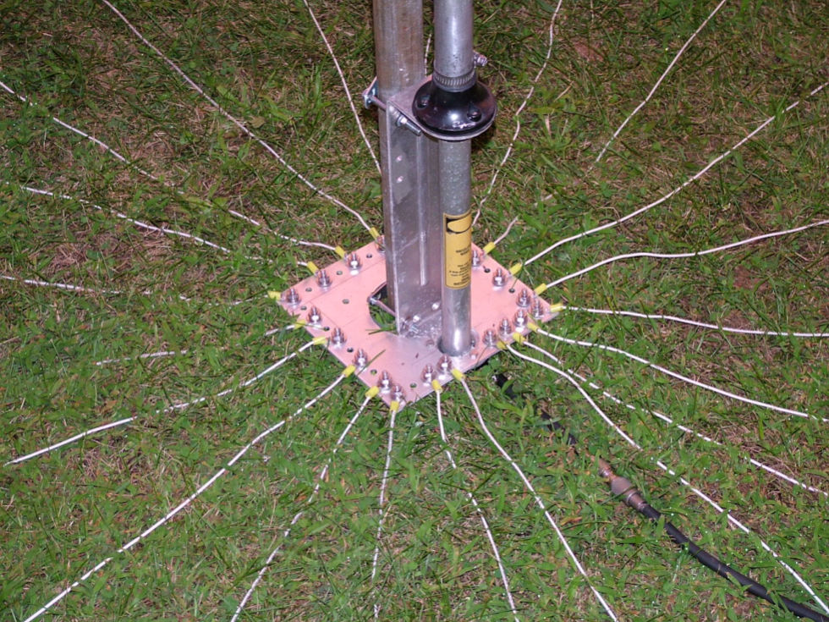
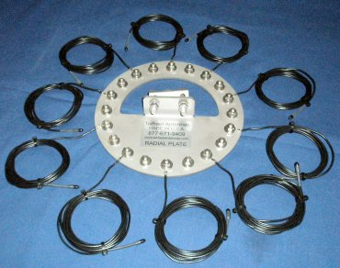
HF Antennas
The radial wires of a ground-mounted vertical antenna system should be placed on the surface or buried a few inches below the ground. (G9B06)
Surface mounted ground wires.
Ground wire kit.

Slide 13
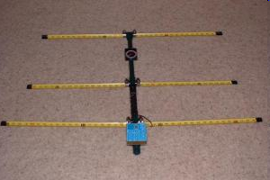
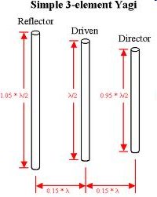
HF Antennas
In a three-element, single-band Yagi antenna, the director is normally the shortest parasitic element and the reflector the longest. (G9C03)
The approximate length of the driven element of a Yagi antenna is 1/2 wavelength. (G9C02)
Director
Driven Element
Reflector

Slide 14
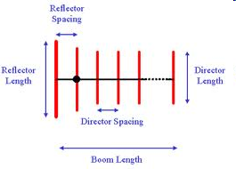
HF Antennas
A directional antenna would be the best HF antenna to use for minimizing interference. (G9C11)
  By definition: An antenna that has a single well-defined direction of maximum gain
    A Yagi or a beam
One disadvantage of a directly fed random-wire antenna is that you may experience RF burns when touching metal objects in your station. (G9B01)
  As the name implies, random-wire antennas are a random-length.
  To match the antenna to the transmitter, you’ll need an antenna tuner
  Because of this, there may be high RF levels in the shack when you are transmitting.

Slide 15
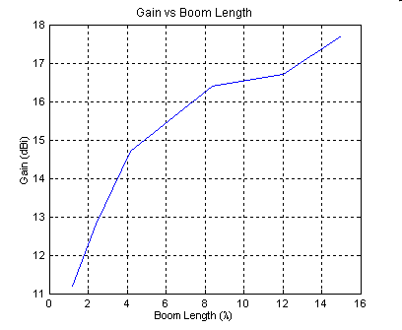
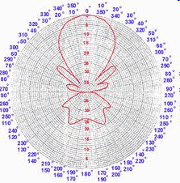
HF Antennas
The gain increases when you increase boom length and add directors to a Yagi antenna. (G9C05)

Slide 16
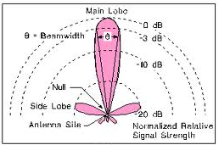
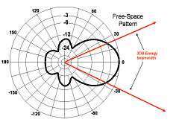
HF Antennas
The “major lobe” or "main lobe" of a directive antenna is the direction of maximum radiated field strength from the antenna. (G9C08)
The "front-to-back ratio" of a Yagi antenna is the power radiated in the major radiation lobe compared to the power radiated in exactly the opposite direction. (G9C07)

Slide 17
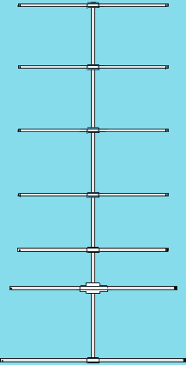
HF Antennas
In a Yagi antenna design, the following variables that could be adjusted to optimize forward gain, front-to-back ratio, or SWR bandwidth (G9C10)
  The physical length of the boom
  The number of elements on the boom
  The spacing of each element along the boom
Larger diameter elements increase the bandwidth of a Yagi antenna. (G9C01)
All of these choices are correct

Slide 18
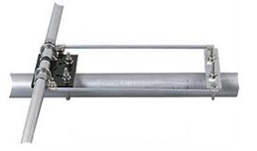
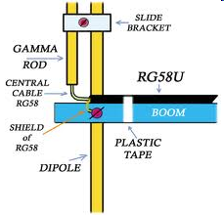
HF Antennas
A beta or hairpin match is a shorted transmission line stub placed at the feedpoint of a yagi. (G9C16)
An advantage of using a gamma match for impedance matching of a Yagi antenna to 50-ohm coax feed line is that it does not require that the elements be insulated from the boom. (G9C12)

Slide 19
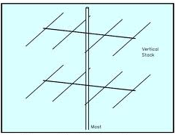
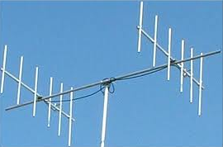
HF Antennas
The advantage of vertical stacking of horizontally polarized Yagi antennas is that it narrows the main lobe in elevation. (G9D05)
Yagi antennas spaced vertically 1/2 wavelength apart typically is approximately 3 dB higher than the gain of a single 3-element Yagi. (G9C09)
Vertical Stacking of Horizontally polarized.
Horizontal Stacking of Vertically polarized.

Slide 20
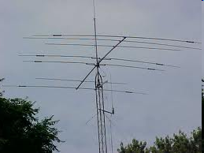
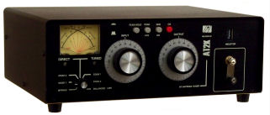
HF Antennas
The primary purpose of antenna traps is to permit multiband operation. (G9D04)
A disadvantage of multiband antennas is that they have poor harmonic rejection. (G9D11)
An antenna tuner or coupler is often used to enable matching the transmitter output to an impedance other than 50 ohms. (G4A06)

Slide 21
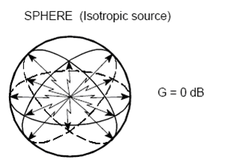
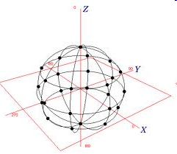
HF Antennas
dBi is compared to an isotropic antenna, dBd is compared to a dipole antenna (G9C15)
dBi gain figures are 2.15 dB higher than dBd gain figures (G9C04)
  dBi refers the signal strength from an ideal point source of energy
  that radiates equally in all directions in a sphere surrounding the point RF source.
  Isotropic radiators are used as reference radiators
  An isotropic radiator is a theoretical point source of electromagnetic or sound waves.

Slide 22
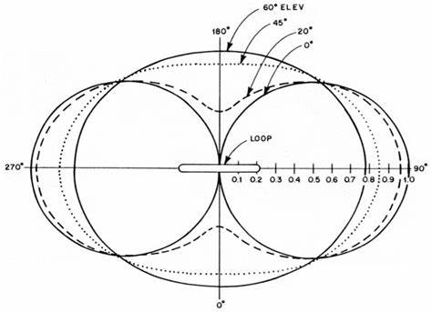
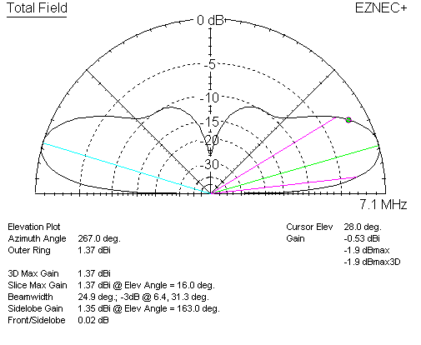
HF Antennas
An electrically small loop (less than 1/3 wavelength) has nulls in its radiation pattern broadside to the loop. (G9D10)
The combined vertical and horizontal radiation pattern of a multi-wavelength loop virtually omnidirectional with a lower peak radiation angle than a dipole. (G9D13)

Slide 23
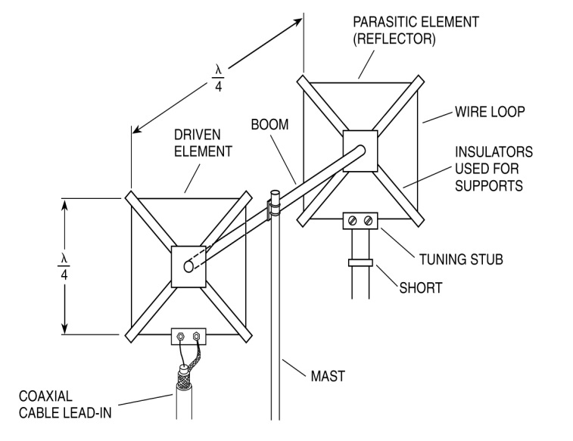
HF Antennas
The elements of a quad antenna are square loops. Each side of a quad antenna driven element is approximately 1/4 wavelength. (G9C13)
The reflector element must be approximately 5% longer than the driven element for a two-element quad antenna when the antenna is meant to operate as a beam antenna, assuming one of the elements is used as a reflector. (G9C06)
Driven Element for each side (in feet) =
1005
f (MHz)
/
4
Horizontal polarization feed-point

Slide 24
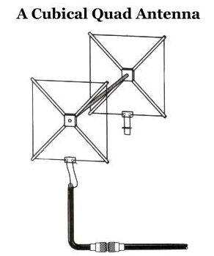
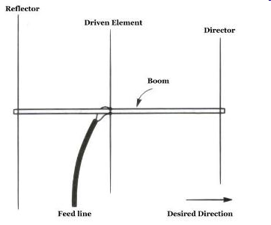
HF Antennas
The forward gain of a two-element quad antenna is about the same as the forward gain of a three-element Yagi antenna. (G9C14)

Slide 25
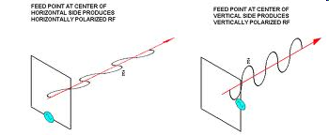
HF Antennas
Each side of a quad antenna reflector element is slightly more than 1/4 wavelength. (G9C15)
The polarization of the radiated signal changes from horizontal to vertical when the feed point of a quad antenna is changed from the center of the either horizontal wire to the center of either vertical wire. (G9C18)

Slide 26

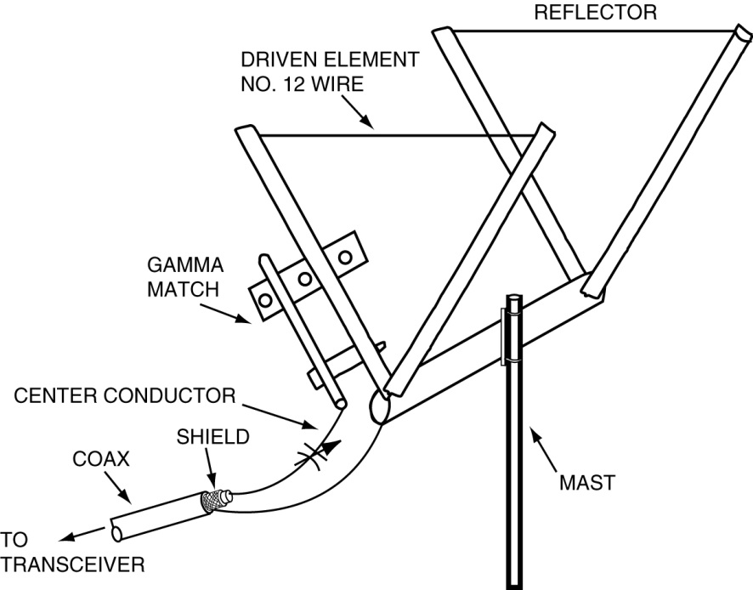
HF Antennas
The gain of a two-element delta-loop beam is about the same as the gain of a two-element quad antenna. (G9C16)
Each leg of a symmetrical delta-loop antenna is approximately 1/3 wavelength. (G9C17)
Driven Element for each side (in feet) =
1005
f (MHz)
/
3

Slide 27
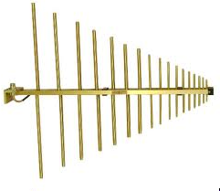
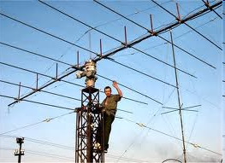
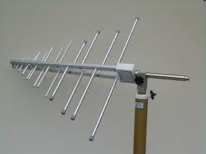
HF Antennas
For a log periodic antenna, the length and spacing of the elements increases logarithmically from one end of the boom to the other. (G9D07)
The gain of a log periodic antenna is less than that of a Yagi, but an advantage of a log periodic antenna is wide bandwidth. (G9D06)
290 – 2000 MHz
EW8DQ, and his rotatable HF log-periodic beam antenna in Belarus
0.15 – 300 MHz

Slide 28
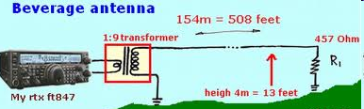
HF Antennas
An application for a Beverage antenna is as a directional receiving for low HF bands. (G9D09)

Slide 29
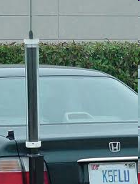
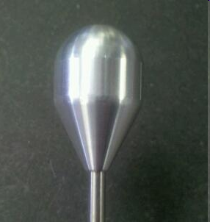
HF Antennas
The antenna system efficiency is the one thing that most limits the effectiveness of an HF mobile installation. (G4E05)
    It is not possible to put a full ¼ wavelength 75 meter antenna on a mobile.
    Any antenna for these frequencies would be inefficient.
One disadvantage of using a shortened mobile antenna as opposed to a full size antenna is that operating bandwidth may be very limited. (G4E06)
The purpose of a "corona ball" on a HF mobile antenna is to reduce high voltage discharge from the tip of the antenna. (G4E02)
    They dissipate static build up from movement through the air caused by vehicle movement

Slide 30
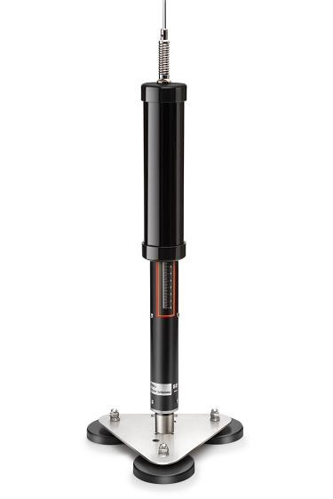
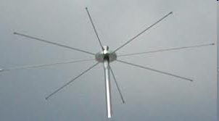

HF Antennas
A "capacitance hat" on a mobile antenna is a device to electrically lengthen a physically short antenna. (G4E01)
A “screwdriver” mobile antenna adjust the feed point impedance by varying the base loading inductance(G9D08)

Slide 31


HF Antennas
The antenna and feed line must be connected to an antenna analyzer when it is being used for SWR measurements. (G4B11)
A use for an antenna analyzer, other than measuring the SWR of an antenna system, is determining the impedance of an unknown or unmarked coaxial cable. (G4B13)
Strong signals from nearby transmitters can affect the accuracy of measurements when making measurements on an antenna system with an antenna analyzer. (G4B12)
Comet CAA-500
MFJ-259B

Slide 32




HF Antennas
A field-strength meter may also be used to monitor relative RF output when making antenna and transmitter adjustments. (G4B08)
The radiation pattern of an antenna can be determined with a field strength meter. (G4B09)

Slide 33


Element 3 General Class Question Pool
HF Antennas
Valid July 1, 2019
Through
June 30, 2023

Slide 34
G9B10 What is the approximate length for a 1/2-wave dipole antenna cut for 14.250 MHz?
8 feet
16 feet
24 feet
33 feet

Slide 35
G9B11 What is the approximate length for a 1/2-wave dipole antenna cut for 3.550 MHz?
42 feet
84 feet
132 feet
263 feet

Slide 36
G9B09 Which of the following is an advantage of a horizontally polarized as compared to vertically polarized HF antenna?
Lower ground reflection losses
Lower feed-point impedance
Shorter Radials
Lower radiation resistance

Slide 37
G3C10 What is Near Vertical Incidence Skywave (NVIS) propagation?
Propagation near the MUF
Short distance MF or HF propagation using high elevation angles
Long path HF propagation at sunrise and sunset
Double hop propagation near the LUF

Slide 38
G9D01 Which of the following antenna types will be most effective as a Near Vertical Incidence Skywave (NVIS) antenna for short-skip communications on 40 meters during the day?
A horizontal dipole placed between 1/10 and 1/4 wavelength above the ground
A vertical antenna placed between 1/4 and 1/2 wavelength above the ground
A left-hand circularly polarized antenna
A right-hand circularly polarized antenna

Slide 39
G9B07 How does the feed-point impedance of a 1/2 wave dipole antenna change as the antenna is lowered from 1/4 wave above ground?
It steadily increases
It steadily decreases
It peaks at about 1/8 wavelength above ground
It is unaffected by the height above ground

Slide 40
G9B08 How does the feed-point impedance of a 1/2 wave dipole change as the feed-point location is moved from the center toward the ends?
It steadily increases
It steadily decrease
It peaks at about 1/8 wavelength from the end
It is unaffected by the location of the feed-point

Slide 41
G9D12 What is the common name of a dipole with a single central support?
Inverted V
Inverted L
Sloper
Lazy H

Slide 42
G9D02 What is the feed-point impedance of an end-fed half-wave antenna?
Very low
Approximately 50 ohms
Approximately 300 ohms
Very high

Slide 43
G9B04 What is the radiation pattern of a dipole antenna in free space in a plane containing the conductor?
It is a figure-eight at right angles to the antenna
It is a figure-eight off both ends of the antenna
It is a circle (equal radiation in all directions)
It has a pair of lobes on one side of the antenna and a single lobe on the other side

Slide 44
G9D03 In which direction is the maximum radiation from a portable VHF/UHF “halo” antenna?
Broadside to the plane of the halo
Opposite the feed point
Omnidirectional in the plane of the halo
Toward the halo’s supporting mast

Slide 45
G9B05 How does antenna height affect the horizontal (azimuthal) radiation pattern of a horizontal dipole HF antenna?
If the antenna is too high, the pattern becomes unpredictable
Antenna height has no effect on the pattern
If the antenna is less than 1/2 wavelength high, the azimuthal pattern is almost omnidirectional
If the antenna is less than 1/2 wavelength high, radiation off the ends of the wire is eliminated

Slide 46
G9B03 Which of the following best describes the radiation pattern of a quarter-wave, ground- plane vertical antenna?
Bi-directional in azimuth
Isotropic
Hemispherical
Omnidirectional in azimuth

Slide 47
G9B12 What is the approximate length for a 1/4-wave vertical antenna cut for 28.5 MHz?
8 feet
11 feet
16 feet
21 feet

Slide 48
G9B06 Where should the radial wires of a ground-mounted vertical antenna system be placed?
As high as possible above the ground
Parallel to the antenna element
On the surface or buried a few inches below the ground
At the top of the antenna

Slide 49
G9C11 Which HF antenna would be the best to use for minimizing interference?
A quarter-wave vertical antenna
An isotropic antenna
A directional antenna
An omnidirectional antenna

Slide 50
G9C03 How do the lengths of a three-element Yagi reflector and director compare to that of the driven element?
The reflector is longer, and the director is shorter
The reflector is shorter, and the director is longer
They are all the same length
Relative length depends on the frequency of operation

Slide 51
G9C02 What is the approximate length of the driven element of a Yagi antenna?
1/4 wavelength
1/2 wavelength
3/4 wavelength
1 wavelength

Slide 52
G9C05 How does increasing boom length and adding directors affect a Yagi antenna?
Gain increases
Beamwidth increases
Weight decreases
Wind load decreases

Slide 53
G9C08 What is meant by the "main lobe" of a directive antenna?
The magnitude of the maximum vertical angle of radiation
The point of maximum current in a radiating antenna element
The maximum voltage standing wave point on a radiating element
The direction of maximum radiated field strength from the antenna

Slide 54
G9C07 What does "front-to-back ratio" mean in reference to a Yagi antenna?
The number of directors versus the number of reflectors
The relative position of the driven element with respect to the reflectors and directors
The power radiated in the major radiation lobe compared to the power radiated in exactly the opposite direction
The ratio of forward gain to dipole gain

Slide 55
G9C10 Which of the following is a Yagi antenna design variable that could be adjusted to optimize forward gain, front-to-back ratio, or SWR bandwidth?
The physical length of the boom
The number of elements on the boom
The spacing of each element along the boom
All of these choices are correct

Slide 56
G9C01 Which of the following would increase the bandwidth of a Yagi antenna?
Larger diameter elements
Closer element spacing
Loading coils in series with the elements
Tapered-diameter elements

Slide 57
G9C12 Which of the following is an advantage of using a gamma match for impedance matching of a Yagi antenna to 50-ohm coax feed line?
It does not require that the elements be insulated from the boom.
It does not require any inductors or capacitors.
It is useful for matching multiband antennas.
All of these choices are correct.

Slide 58
G9C16 What is a beta or hairpin match?
It is a shorted transmission line stub placed at the feed point of a Yagi antenna to provide impedance matching
It is a ¼ wavelength section of 75 ohm coax in series with the feed point of a Yagi to provide impedance matching
It is a series capacitor selected to cancel the inductive reactance of a folded dipole antenna
It is a section of 300 ohm twinlead used to match a folded dipole antenna

Slide 59
G9D05 What is the advantage of vertical stacking of horizontally polarized Yagi antennas?
Allows quick selection of vertical or horizontal polarization
Allows simultaneous vertical and horizontal polarization
Narrows the main lobe in azimuth
Narrows the main lobe in elevation

Slide 60
G9C09 How does the gain of two three-element, horizontally polarized Yagi antennas spaced vertically 1/2 wavelength apart typically compare to the gain of a single three-element Yagi?
Approximately 1.5 dB higher
Approximately 3 dB higher
Approximately 6 dB higher
Approximately 9 dB higher

Slide 61
G9D04 What is the primary purpose of antenna traps?
To permit multiband operation
To notch spurious frequencies
To provide balanced feed-point impedance
To prevent out-of-band operation

Slide 62
G2D11 Which HF antenna would be the best to use for minimizing interference?
A quarter wave vertical antenna
An isotropic antenna
A unidirectional antenna
An omnidirectional antenna

Slide 63
G9B01 What is one disadvantage of a directly fed random-wire antenna?
It must be longer than 1 wavelength
You may experience RF burns when touching metal objects in your station
It produces only vertically polarized radiation
It is not effective on the higher HF bands

Slide 64
G4A06 What type of device is often used to enable matching the transmitter output to an impedance other than 50 ohms?
Balanced modulator.
SWR Bridge.
Antenna coupler or antenna tuner.
Q Multiplier.

Slide 65
G9C15 What is meant by the terms dBi and dBd when referring to antenna gain?
dBi refers to an isotropic antenna, dBd refers to a dipole antenna
dBi refers to an ionospheric reflecting antenna, dBd refers to a dissipative antenna
dBi refers to an inverted-vee antenna, dBd refers to a downward reflecting antenna
dBi refers to an isometric antenna, dBd refers to a discone antenna

Slide 66
G9C04 How does antenna gain stated in dBi compare to gain stated in dBd for the same antenna?
dBi gain figures are 2.15 dB lower than dBd gain figures
dBi gain figures are 2.15 dB higher than dBd gain figures
dBi gain figures are the same as the square root of dBd gain figures multiplied by 2.15
dBi gain figures are the reciprocal of dBd gain figures + 2.15 dB

Slide 67
G9D10 In which direction or directions does an electrically small loop (less than 1/3 wavelength in circumference) have nulls in its radiation pattern?
In the plane of the loop
Broadside to the loop
Broadside and in the plane of the loop
Electrically small loops are omnidirectional

Slide 68
G9D13 What is the combined vertical and horizontal polarization pattern of a multi-wavelength, horizontal loop antenna?
A figure-eight, similar to a dipole
Four major loops with deep nulls
Virtually omnidirectional with a lower peak vertical radiation angle than a dipole
Radiation maximum is straight up

Slide 69
G9C13 Approximately how long is each side of a quad antenna driven element?
¼ wavelength.
½ wavelength.
¾ wavelength.
1 wavelength.

Slide 70
G9C14 How does the forward gain of a two-element quad antenna compare to the forward gain of a three-element Yagi antenna?
About the same.
About 2/3 as much.
About 1.5 times as much.
About twice as much.

Slide 71
G9C06 What configuration of the loops of a two-element quad antenna must be used for the antenna to operate as a beam antenna, assuming one of the elements is used as a reflector?
The driven element must be fed with a balun transformer.
The driven element must be open-circuited on the side opposite the feed point.
The reflector element must be approximately 5% shorter than the driven element.
The reflector element must be approximately 5% longer than the driven element.

Slide 72
G9D07 Which of the following describes a log periodic antenna?
Length and spacing of element increases logarithmically from one end of the boom to the other
Impedance varies periodically as a function of frequency
Gain varies logarithmically as a function of frequency
SWR varies periodically as a function of boom length

Slide 73
G9D06 Which of the following is an advantage of a log periodic antenna?
Wide bandwidth
Higher gain per element than a Yagi antenna
Harmonic suppression
Polarization diversity

Slide 74
G9D09 What is the primary use of a Beverage antenna?
Directional receiving for low HF bands
Directional transmitting for low HF bands
Portable direction finding at higher HF frequencies
Portable direction finding at lower HF frequencies

Slide 75
G4E05 Which of the following most limits an HF mobile installation?
“Picket Fencing” signal variation
The wire gauge of the DC power line to the transceiver
The antenna system
FCC rules limiting mobile output power on the 75 meter band

Slide 76
G4E06 What is one disadvantage of using a shortened mobile antenna as opposed to a full size antenna?
Short antennas are more likely to cause distortion of transmitted signals.
Short antennas can only receive vertically polarized signals.
Operating bandwidth may be very limited.
Harmonic radiation may increase.

Slide 77
G9D08 How does a “screwdriver” mobile antenna adjust its feed-point impedance?
By varying its body capacitance
By varying the base loading inductance
By extending and retracting the whip
By deploying a capacitance hat

Slide 78
G4E01 What is the purpose of a capacitance hat on a mobile antenna?
To increase the power handling capacity of a mobile whip antenna.
To allows automatic band-changing for a mobile antenna.
To electrically lengthen a physically short antenna.
To allow remote tuning of a mobile antenna.

Slide 79
G4E02 What is the purpose of a “corona ball” on a HF mobile antenna?
To narrow the operating bandwidth of the antenna.
To increase the “Q” of the antenna.
To reduce the chance of damage if the antenna should strike an object.
To reduce high voltage discharge from the tip of the antenna.

Slide 80
G4B11 Which of the following must be connected to an antenna analyzer when it is being used for SWR measurements?
Receiver.
Transmitter.
Antenna and feed line.
All of these choices are correct.

Slide 81
G4B13 What is a use for an antenna analyzer other than measuring the SWR of an antenna system?
Measuring the front to back ratio of an antenna.
Measuring the turns ratio of a power transformer.
Determining the impedance of an unknown or unmarked coaxial cable.
Determining the gain of a directional antenna.

Slide 82
G4B12 What problem can occur when making measurements on an antenna system with an antenna analyzer?
SWR readings may be incorrect if the antenna is too close to the Earth.
Strong signals from nearby transmitters can affect the accuracy of measurements.
The analyzer can be damaged if measurements outside the ham bands are attempted.
Connecting the analyzer to an antenna can cause it to absorb harmonics.

Slide 83
G4B08 Which of the following instruments may be used to monitor relative RF output when making antenna and transmitter adjustments?
A field-strength meter
An antenna noise bridge
A multimeter
A Q meter

Slide 84
G4B09 Which of the following can be determined with a field strength meter?
The radiation resistance of an antenna
The radiation pattern of an antenna
The presence and amount of phase distortion of a transmitter
The presence and amount of amplitude distortion of a transmitter

