Slide 1
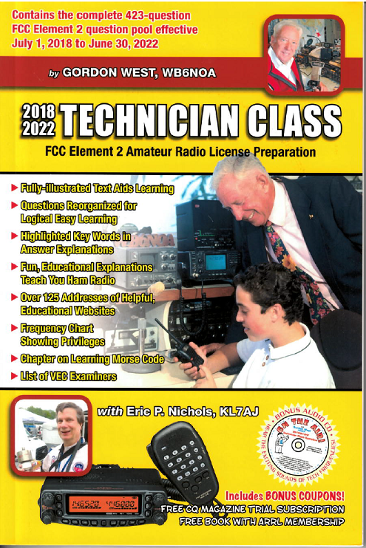
Technician Licensing Class
About Ham Radio
Valid July 1, 2018
Through
June 30, 2022
Notes:
1

Slide 2
Amateur Radio Technician Class Element 2 Course Presentation
ELEMENT 2 SUB-ELEMENTS (Groupings)
About Ham Radio
Call Signs
Control
Mind the Rules
Tech Frequencies
Your First Radio
Going Solo
Repeaters
Emergency!
Weak Signal Propagation
2

Slide 3
Amateur Radio Technician Class Element 2 Course Presentation
ELEMENT 2 SUB-ELEMENTS (Groupings)
Talk to Outer Space!
Your Computer Goes Ham Digital!
Multi-Mode Radio Excitement
Run Some Interference Protection
Electrons – Go With the Flow!
It’s the Law, per Mr. Ohm!
Picture This!
Antennas
Feed Me With Some Good Coax!
Safety First!
3

Slide 4
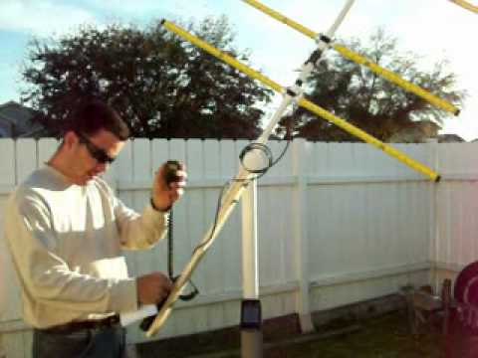
About Ham Radio
The Federal Communications Commission (FCC) makes and enforces all Amateur Radio rules in the United States. T1A02
Advancing skills in the technical and communications phases of the radio art is one purpose clearly spelled out in the FCC rules T1A01
4

Slide 5
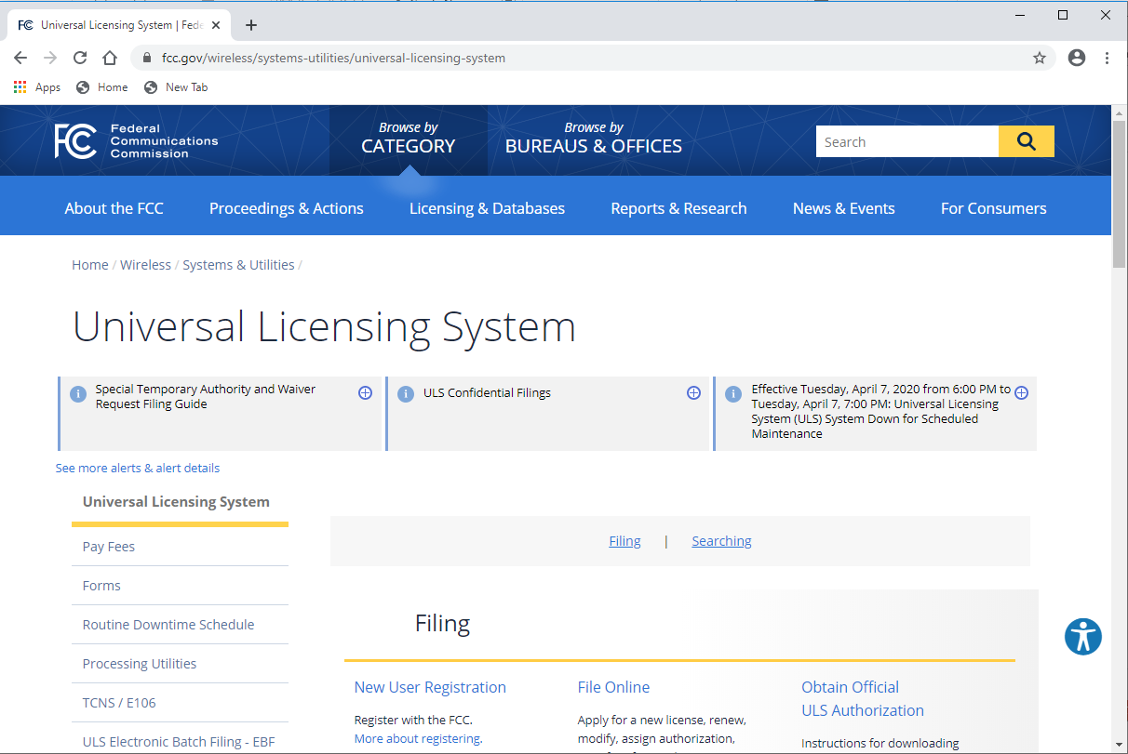
About Ham Radio
The control operator’s operator/primary station license must appear in the FCC ULS database as proof of possession of a license. T1A05
5

Slide 6
About Ham Radio
The FCC issues only three ham licenses:
Technician
General
Amateur Extra T1C01
After passing your examination for your license, as soon as your operator/station license grant appears in the FCC’s ULS database, you may operate on the air. T1C10
6

Slide 7
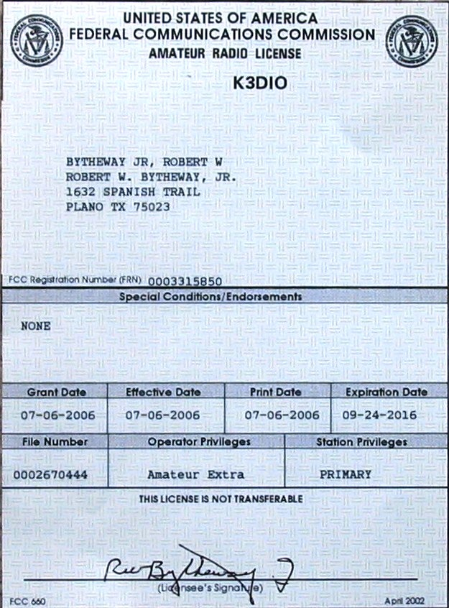
About Ham Radio
You can hold only one operator/primary station license. T1A04
Amateur station licenses
are granted for a term of
10 years. T1C08
There is a 2-year grace period to renew an expired license. T1C09
7

Slide 8
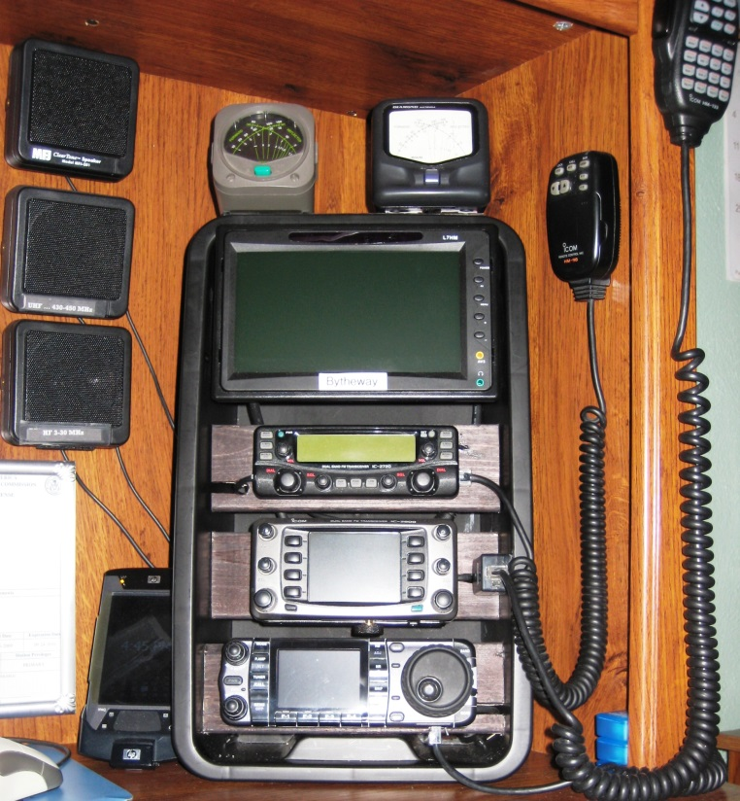
About Ham Radio
With your license expired, and during the grace period, you are not permitted to transmit until the FCC license database shows that your license has been renewed.
No transmitting during the 2-year grace period! T1C11
8

Slide 9
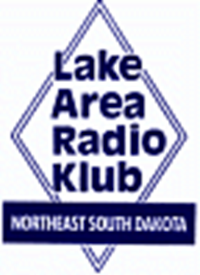
Element 2 Technician Class Question Pool
About Ham Radio
Valid July 1, 2018
Through
June 30, 2022

Slide 10
T1A02 Which agency regulates and enforces the rules for the Amateur Radio Service in the United States?
FEMA
The ITU
The FCC
Homeland Security

Slide 11
T1A01 Which of the following is a purpose of the Amateur Radio Service as stated in the FCC rules and regulations?
A. Providing personal radio communications for as many citizens as possible
B. Providing communications for international non-profit organizations
C. Advancing skills in the technical and communication phases of the radio art
D. All of these choices are correct

Slide 12
T1C01 For which licenses classes are new licenses currently available from the FCC?
Novice, Technician, General, Advanced
Technician, Technician Plus, General, Advanced
Novice, Technician Plus, General, Advanced
Technician, General, Amateur Extra

Slide 13
T1C10 How soon after passing the examination for your first amateur radio license may you operate a transmitter on an amateur service frequency?
Immediately
30 days after the test date
As soon as your operator/station license grant appears in the FCC’s ULS database
You must wait until you receive your license in the mail from the FCC

Slide 14
T1A05 What is proof of possession of an FCC-issued operator/primary license grant?
A printed operator/primary station license issued by the FCC must be displayed at the transmitter site
The control operator must have an operator/primary station license in his or her possession when in control of a transmitter
The control operator’s operator/primary station license must appear in the FCC ULS consolidated license database
All of these choices are correct

Slide 15
T1A12 Which of the following is a permissible use of the Amateur Radio Service?
A. Broadcasting music and videos to friends
B. Providing a way for amateur radio operators to earn additional income by using their stations to pass messages
C. Providing low-cost communications for start-up businesses
D. Allowing a person to conduct radio experiments and to communicate with other licensed hams around the world

Slide 16
T1A05 Which of the following is a purpose of the Amateur Radio Service rules and regulations as defined by the FCC ?
Enhancing international goodwill
Providing inexpensive communication for local emergency organizations
Training of operators in military radio operating procedures
All of these choices are correct

Slide 17
T1A04 How many operator/primary station license grants may be held by any one person?
One
No more than two
One for each band on which the person plans to operate
One for each permanent station location from which the person plans to operate

Slide 18
T1C08 What is the normal term for an FCC-issued primary station/operator license grant?
Five years
Life
Ten years
Twenty years

Slide 19
T1C09 What is the grace period following the expiration of an amateur license within which the license may be renewed?
Two years
Three years
Five years
Ten years

Slide 20
T1C11 If your license has expired and is still within the allowable grace period, may you continue to operate a transmitter on amateur service frequencies?
No, transmitting is not allowed until the ULS database shows that the license has been renewed
Yes, but only if you identify using the suffix GP
Yes, but only during authorized nets
Yes, for up to two years

