Slide 1

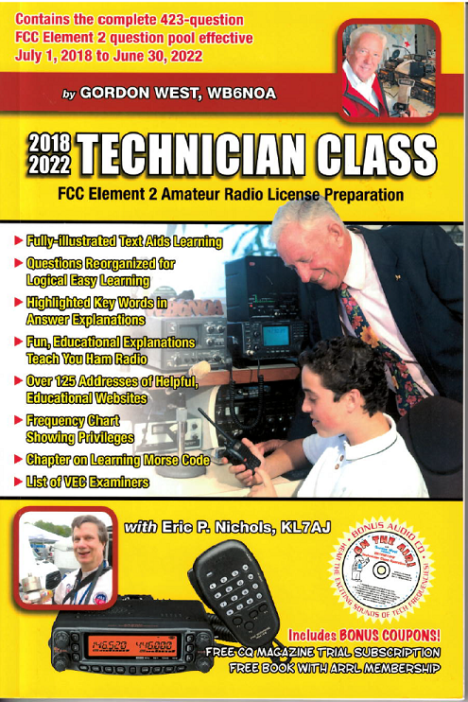
Technician Licensing Class
Call Signs
Valid July 1, 2018
Through
June 30, 2022
Notes:
1

Slide 2
Amateur Radio Technician Class
Element 2 Course Presentation
ELEMENT 2 SUB-ELEMENTS (Groupings)
  About Ham Radio
  Call Signs
  Control
  Mind the Rules
  Tech Frequencies
  Your First Radio
  Going Solo
  Repeaters
  Emergency!
  Weak Signal Propagation
2

Slide 3
Amateur Radio Technician Class
Element 2 Course Presentation
ELEMENT 2 SUB-ELEMENTS (Groupings)
  Talk to Outer Space!
  Your Computer Goes Ham Digital!
  Multi-Mode Radio Excitement
  Run Some Interference Protection
  Electrons – Go With the Flow!
  It’s the Law, per Mr. Ohm!
  Picture This!
  Antennas
  Feed Me With Some Good Coax!
  Safety First!
3

Slide 4
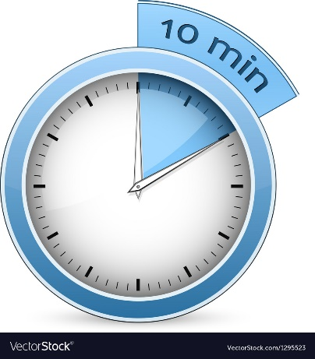
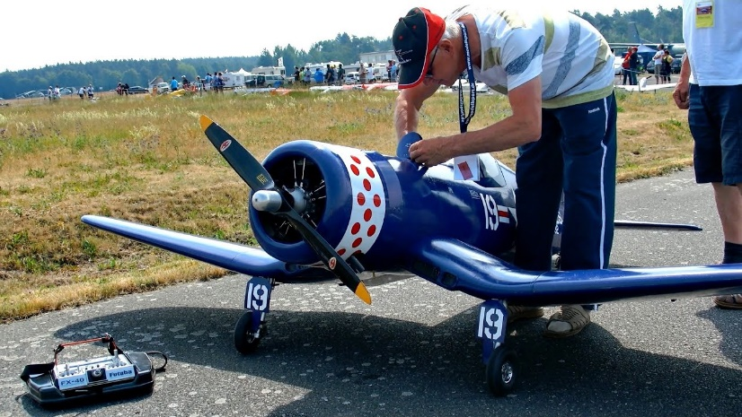
Call Signs
Requirements for transmitting your call sign station ID – every 10 minutes and at the end of your transmission. T1F03
Unidentified transmissions are permitted when transmitting signals to control a model craft.
        All other unidentified transmissions are prohibited. T1D11

Slide 5
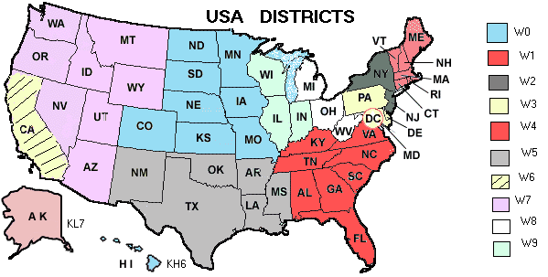
Call Signs
Any licensed amateur can request a vanity call sign. T1C02
K1XXX is an example of a Technician Class licensee call sign T1C05
5

Slide 6
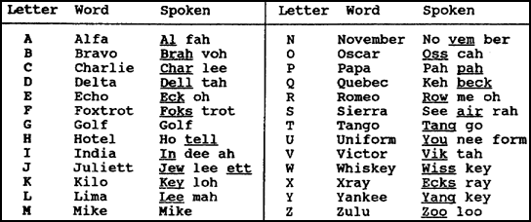
Call Signs
  Use of a phonetic alphabet is encouraged by the FCC when identifying your station when using phone. T1A03
6

Slide 7
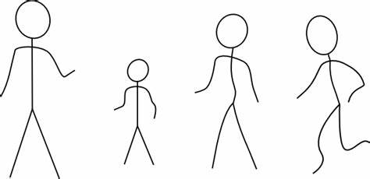
Call Signs
  At least 4 persons are required to be members of a club for a club station license to be issued by the FCC. T1F11
  At a community service net with use of tactical identifiers, your station’s FCC-assigned call sign must be transmitted at the end of each communication and every ten minutes during a communication. T1F02
7

Slide 8
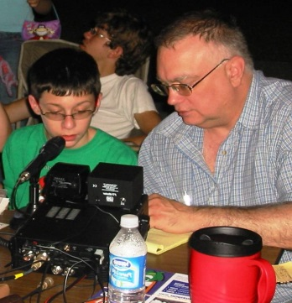
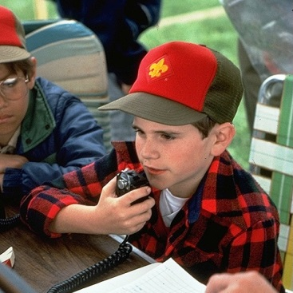
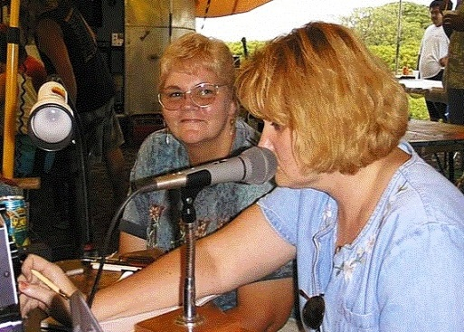
Call Signs
  The English language is an acceptable language for station identification when operating in a phone sub-band. T1F04
  Formats of stroke, slant, or slash are formats of self-assigned indicators acceptable while using phone transmission. T1F06
  A message from a control operator of one station to the control operator of another station on behalf of another person is “Third Party Communications”.T1F08
8

Slide 9
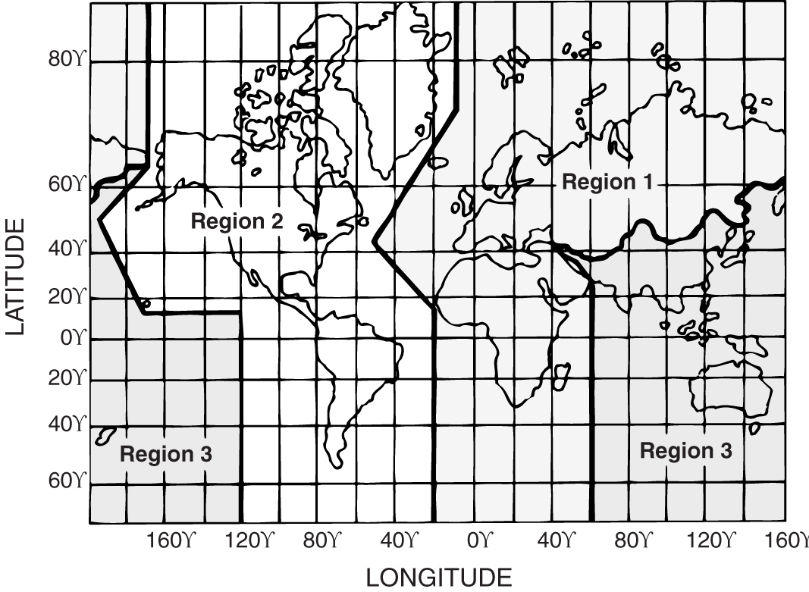
Call Signs
  The ITU is a worldwide United Nations agency for information and communication technology issues. T1B01
9

Slide 10

Call Signs
  Any country whose administration notifies the ITU that they object to communications with FCC-licensed amateur stations results in prohibition from exchanging communications. T1D01
  Communications incidental to the purposes of the amateur service and remarks of a personal character are the types of international communications permitted by FCC-licensed amateur stations. T1C03
10

Slide 11
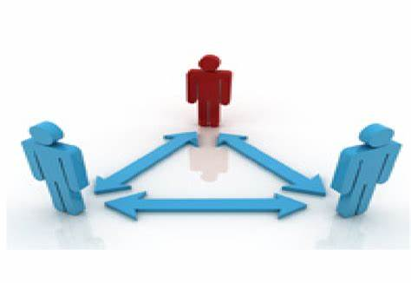
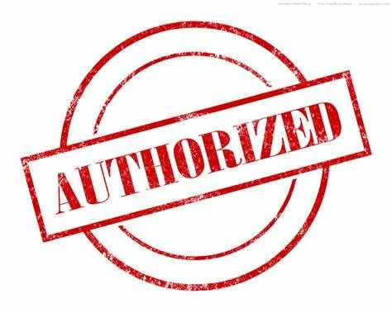
Call Signs
  When a non-licensed person speaks to a foreign station using a station under the control of a Technician Class control operator, the foreign station must be one with which the U.S. has a third party agreement. T1F07
  U.S. amateurs are allowed to operate their amateur station in a foreign country when the foreign country authorizes it. T1C04
11

Slide 12
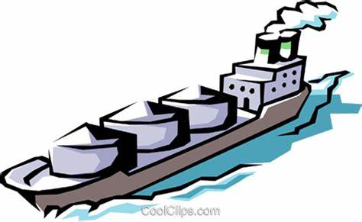
Call Signs
  FCC-licensed amateur stations may transmit from any vessel or craft located in international waters and documented or registered in the United States, in addition to places where the FCC regulates communications. T1C06
12

Slide 13
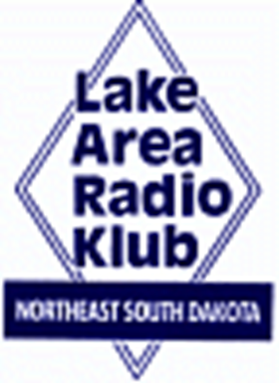
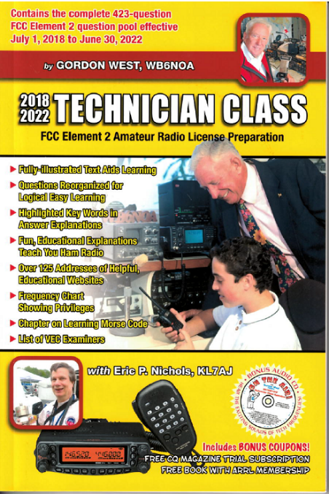
Element 2 Technician Class Question Pool
Call Signs
Valid July 1, 2018
Through
June 30, 2022

Slide 14
T1F03 When is an amateur station required to transmit its assigned call sign?
At the beginning of each contact, and every 10 minutes thereafter
At least once during each transmission
At least every 15 minutes during and at the end of a communication
At least every 10 minutes during and at the end of a communication

Slide 15
T1D11 When may an amateur station transmit without identifying?
When the transmissions are of a brief nature to make station adjustments
When the transmissions are unmodulated
When the transmitted power level is below 1 watt
When transmitting signals to control a model craft

Slide 16
T1C02 Who may select a desired call sign under the vanity call sign rules?
Only licensed amateurs with general or extra class licenses
Only licensed amateurs with an extra class license
Only an amateur licensee who has been licensed continuously for more than 10 years
Any licensed amateur

Slide 17
T1C05 Which of the following is a valid call sign for a Technician class Amateur Radio station?
K1XXX
KA1X
W1XX
All of the choices are correct

Slide 18
T1A03 What are the FCC rules regarding the use of a phonetic alphabet for station identification in the Amateur Radio Service?
It is required when transmitting emergency messages
It is prohibited
It is required when in contact with foreign stations
It is encouraged

Slide 19
T1F11 Which of the following is a requirement for the issuance of a club station license grant?
The trustee must have an Amateur Extra class operator license grant
The club must have at least four members
The club must be registered with the American Radio Relay League
All of these choices are correct

Slide 20
T1F02 When using tactical identifiers such as “Race Headquarters” during a community service net operations, how often must your station transmit the station’s FCC- assigned call sign?
Never, the tactical call is sufficient
Once during every hour
At the end of each communication and every ten minutes during a communication
At the end of every transmission

Slide 21
T1F04 Which of the following is an acceptable language to use for station identification when operating in the phone sub-band?
Any language recognized by the United Nations
Any language recognized by the ITU
The English language
English, French, or Spanish

Slide 22
T1F06 Which of the following formats of a self-assigned indicator is acceptable when identifying using a phone transmission?
KL7CC stroke W3
KL7CC slant W3
KL7CC slash W3
All of these choices are correct

Slide 23
T1B01 What is the Intenational Telecommunications Union (ITU) ?
An agency of the United States Department of Telecommunications Management
A United Nations agency for information and communication technology issues
An independent frequency coordination agency
A department of the FCC

Slide 24
T1D01 With which countries are FCC-licensed amateur stations prohibited from exchanging communications?
Any country whose administration has notified the ITU that it objects to such communications
B. Any country whose administration has notified the ARRL that it objects to such communications
C. Any country engaged in hostilities with another country
D. Any country in violation of the War Powers Act of 1934

Slide 25
T1C03 What types of international communications are permitted by an FCC-licensed amateur station?
Communications incidental to the purposes of the amateur service and remarks of a personal character
Communications incidental to conducting business or remarks of a personal nature
Only communications incidental to contest exchanges, all other communications are prohibited
Any communications that would be permitted on an international broadcast station

Slide 26
T1F08 What is meant by the term Third Party Communications?
A message from a control operator to another amateur station control operator on behalf of another person
Amateur radio communications where three stations are in communications with one another
Operation when the transmitting equipment is licensed to a person other than the control operator
Temporary authorization for an unlicensed person to transmit on the amateur bands for technical experiments

Slide 27
T1F07 Which of the following restrictions apply when a non- licensed person is allowed to speak to a foreign station using a station under the control of a Technician Class control operator ?
The person must be a U.S. citizen
The foreign station must be one with whom the U.S. has a third party agreement
The licensed control operator must do the station identification
All of these choices are correct

Slide 28
T1C04 When are you allowed to operate your amateur station in a foreign country?
When the foreign country authorizes it
When there is a mutual agreement allowing third party communications
When authorization permits amateur communications in a foreign language
When you are communicating with non-licensed individuals in another country

Slide 29
T1C06 From which of the following locations may an FCC- licensed amateur station transmit, in addition to places where the FCC regulates communications?
  From within any country that belongs to the International Telecommunications Union
  From within any country that is a member of the United Nations
  From anywhere within in ITU Regions 2 and 3
  From any vessel or craft located in international waters and documented or registered in the United States

