Slide 1

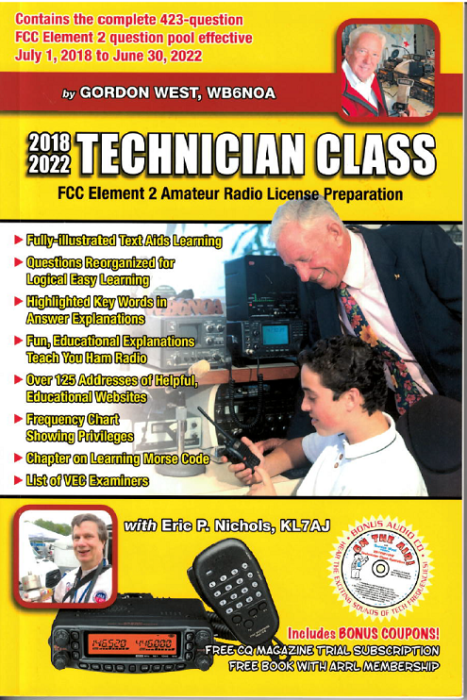
Technician Licensing Class
Mind the Rules
Valid July 1, 2018
Through
June 30, 2022
Notes:
1

Slide 2
Amateur Radio Technician Class
Element 2 Course Presentation
ELEMENT 2 SUB-ELEMENTS (Groupings)
  About Ham Radio
  Call Signs
  Control
  Mind the Rules
  Tech Frequencies
  Your First Radio
  Going Solo
  Repeaters
  Emergency!
  Weak Signal Propagation
2

Slide 3
Amateur Radio Technician Class
Element 2 Course Presentation
ELEMENT 2 SUB-ELEMENTS (Groupings)
  Talk to Outer Space!
  Your Computer Goes Ham Digital!
  Multi-Mode Radio Excitement
  Run Some Interference Protection
  Electrons – Go With the Flow!
  It’s the Law, per Mr. Ohm!
  Go Picture These!
  Antennas
  Feed Me With Some Good Coax!
  Safety First!
3

Slide 4
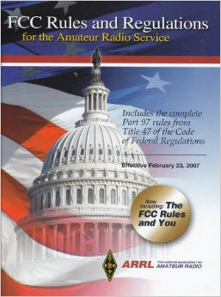
Mind the Rules
  Transmission of language that may be considered indecent or obscene is prohibited. T1D06
  At no time is willful interference to other amateur radio stations ever permitted. T1A11
4

Slide 5
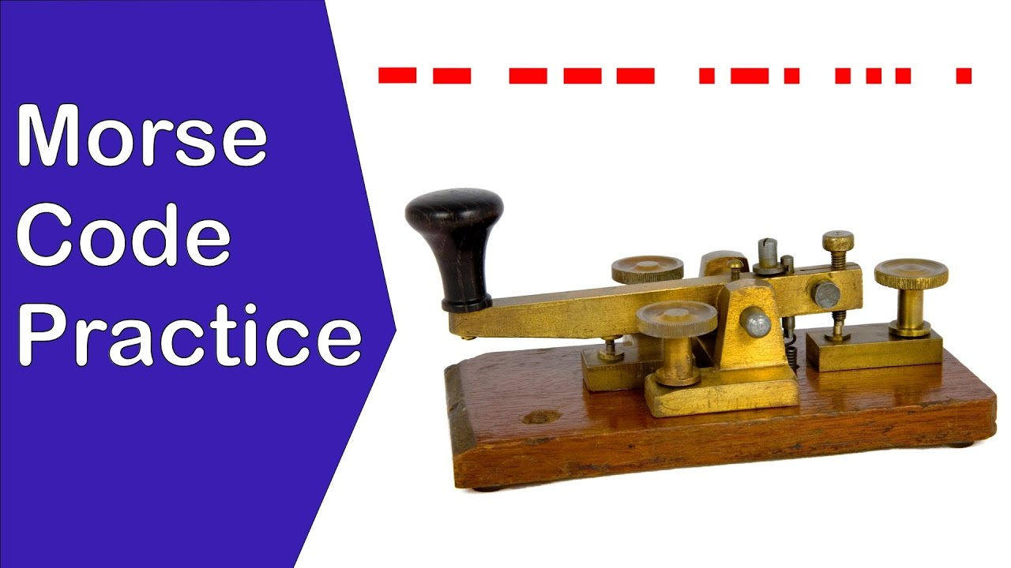
Mind the Rules
  Transmission intended for reception by the general public is termed “broadcasting” in the FCC rules for the amateur services. T1D10
  Amateur radio station may engage in broadcasting when transmitting code practice, information bulletins, or transmissions necessary to provide emergency communications. T1D02
5

Slide 6
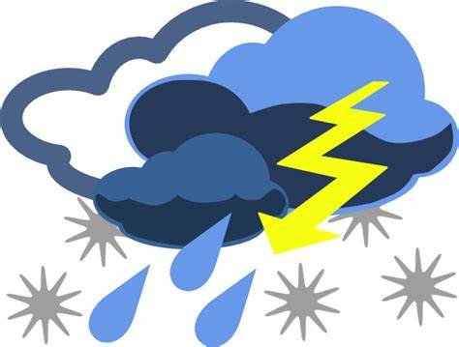
Mind the Rules
  Assuming no other means is available, amateur stations are authorized to transmit signals related to broadcasting, program production, or news gathering, only where such communications directly relate to the immediate safety of human life or protection of property. T1D09
6

Slide 7
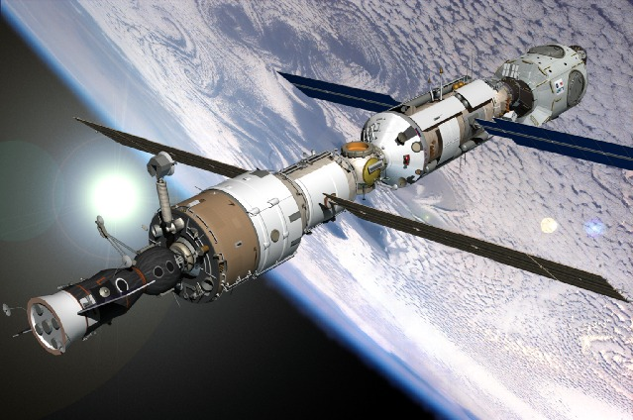
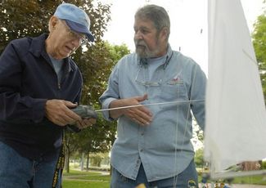
Mind the Rules
  Transmission of codes or ciphers that hide the meaning of a message is allowed by an amateur station only when transmitting control commands to space stations or radio control craft. T1D03
7

Slide 8

Mind the Rules
  The only time an amateur station is authorized to transmit music is when incidental to an authorized retransmission of manned spacecraft communications. T1D04
8

Slide 9
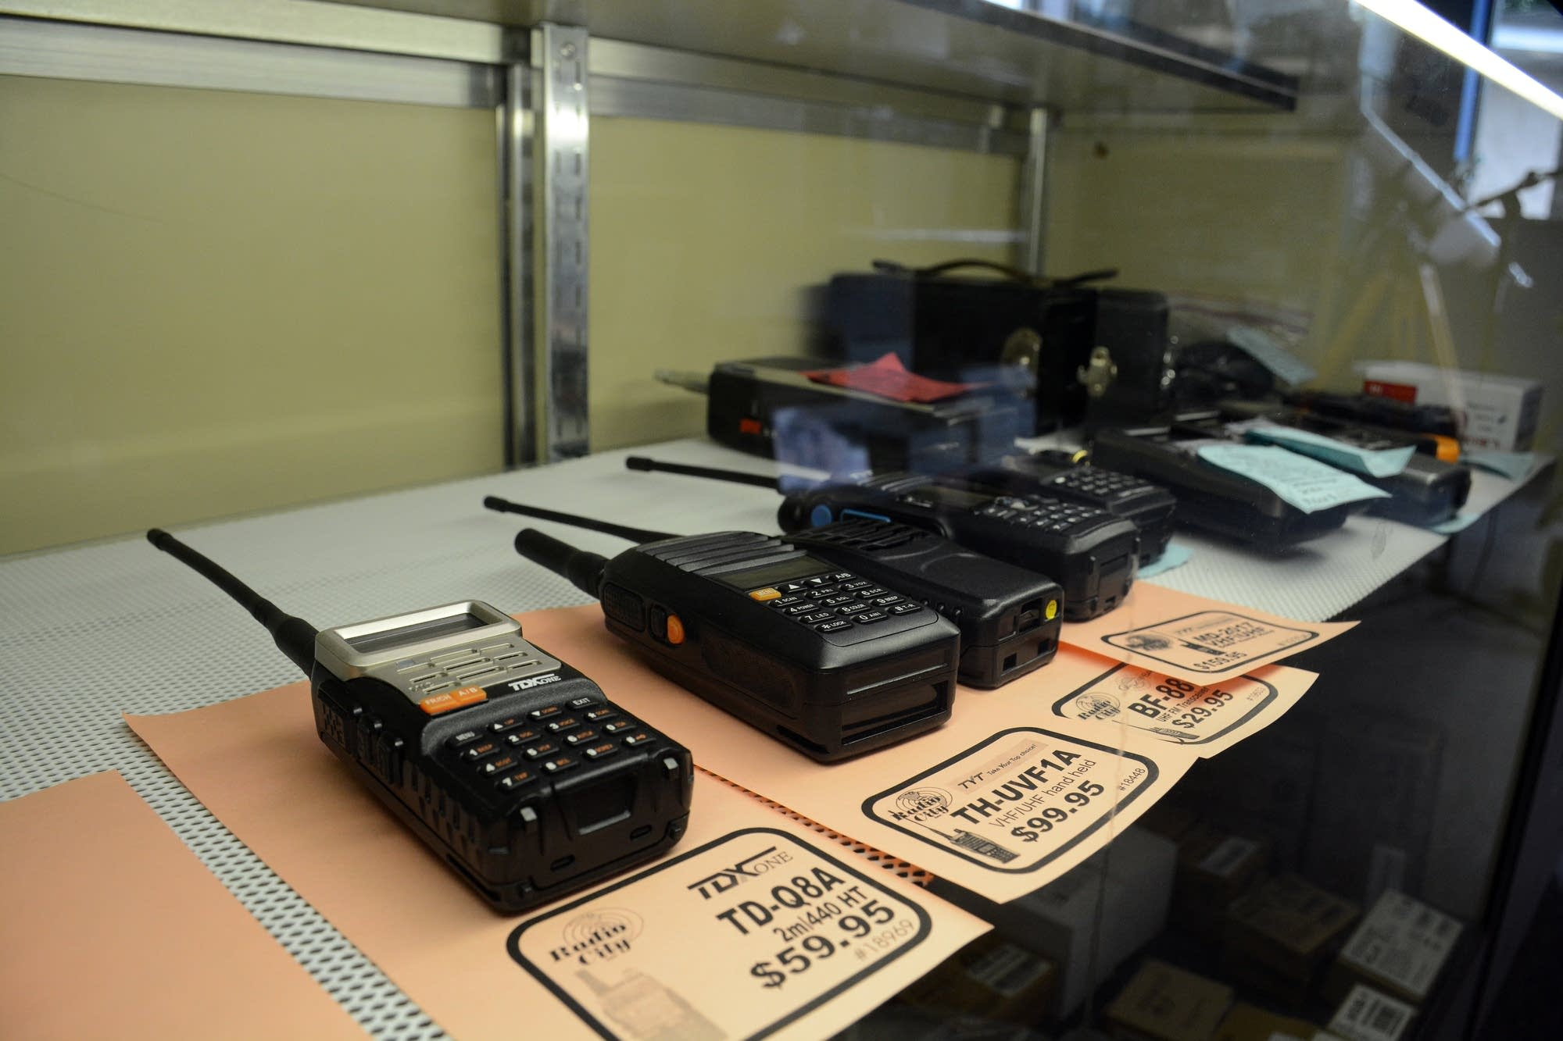
Mind the Rules
  Amateur radio operators may use their stations to notify other amateurs of the availability of equipment for sale or trade when the equipment is normally used in an amateur station and such activity is not conducted on a regular basis. T1D05
9

Slide 10

Mind the Rules
  The station licensee must make the station and its records available for FCC inspection at any time upon request by an FCC representative. T1F01
  Revocation of the station license or suspension of the operator license is possible when correspondence from the FCC is returned as undeliverable because the grantee failed to provide the correct mailing address. T1C07
10

Slide 11

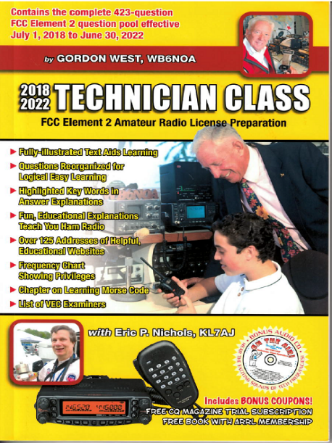
Element 2 Technician Class Question Pool
Mind the Rules
Valid July 1, 2018
Through
June 30, 2022

Slide 12
T1D06 What, if any, are the restrictions concerning transmission of language that may be considered indecent or obscene?
The FCC maintains a list of words that are not permitted to be used on amateur frequencies
Any such language is prohibited
The ITU maintains a list of words that are not permitted to be used on amateur frequencies
There is no such prohibition

Slide 13
T1A11 When is willful interference to other amateur radio stations permitted?
Only if the station interfered is expressing extreme religious or political views
At no time
Only during a contest
At any time, amateurs are not protected from willful interference

Slide 14
T1D10 What is the meaning of the term ”broadcasting” in the FCC rules for the amateur services?
Two-way transmissions by amateur stations
Transmission of music
Transmission of messages directed only to amateur operators
Transmissions intended for reception by the general public

Slide 15
T1D02 Under which of the following circumstances may an amateur radio station engage in broadcasting?
Under no circumstances
When transmitting code practice, information bulletins, or transmissions necessary to provide emergency communications
At any time as long as no music is transmitted
At any time as long as the material being transmitted did not originate from a commercial broadcast station

Slide 16
T1D09 Under which of the following circumstances are amateur stations authorized to transmit signals related to broadcasting, program production, or news gathering, assuming no other means is available?
Only where such communications directly relate to the immediate safety of human life or protection of property
Only when broadcasting communications to or from the space shuttle.
Only where noncommercial programming is gathered and supplied exclusively to the National Public Radio network
Only when using amateur repeaters linked to the Internet

Slide 17
T1D03 When is the transmission of codes or ciphers that hide the meaning of a message allowed by an amateur station?
Only during contests
Only when operating mobile
Only when transmitting control commands to space stations or radio control craft
Only when frequencies above 1280 MHz are used

Slide 18
T1D04 What is the only time an amateur station is authorized to transmit music?
When incidental to an authorized retransmission of manned spacecraft communications
B. When the music produces no spurious emissions
C. When the purpose is to interfere with an illegal transmission
D. When the music is transmitted above 1280 MHz

Slide 19
T1D05 When may amateur radio operators use their stations to notify other amateurs of the availability of equipment for sale or trade?
When the equipment is normally used in an amateur station and such activity is not conducted on a regular basis
B. When the asking price is $100.00 or less
C. When the asking price is less than its appraised value
D. When the equipment is not the personal property of either the station licensee or the control operator or their close relatives

Slide 20
T1F01 When must the station licensee make the station and its records available for FCC inspection?
At any time ten days after notification by the FCC of such an inspection
Any time upon request by an FCC representative
Only after failing to comply with an FCC notice of violation
Only when presented with a valid warrant by an official or government agent

Slide 21
T1C07 What may result when correspondence from the FCC is returned as undeliverable because the grantee failed to provide the correct mailing address?
Fine or imprisonment
Revocation of the station license or suspension of the operator license
Require the licensee to be re-examined
A reduction of one rank in operator class

