Slide 1

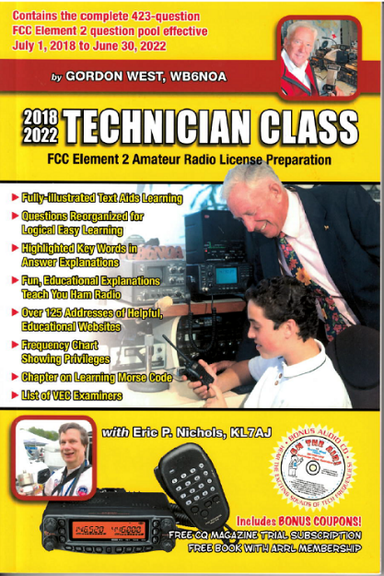
Technician Licensing Class
Going Solo – Your First Amateur Radio Transmission
Valid July 1, 2018
Through
June 30, 2022
Notes:
1

Slide 2
Amateur Radio Technician Class
Element 2 Course Presentation
ELEMENT 2 SUB-ELEMENTS (Groupings)
  About Ham Radio
  Call Signs
  Control
  Mind the Rules
  Tech Frequencies
  Your First Radio
  Going Solo
  Repeaters
  Emergency!
  Weak Signal Propagation
2

Slide 3
Amateur Radio Technician Class
Element 2 Course Presentation
ELEMENT 2 SUB-ELEMENTS (Groupings)
  Talk to Outer Space!
  Your Computer Goes Ham Digital!
  Multi-Mode Radio Excitement
  Run Some Interference Protection
  Electrons – Go With the Flow!
  It’s the Law, per Mr. Ohm!
  Go Picture These!
  Antennas
  Feed Me With Some Good Coax!
  Safety First!
3

Slide 4
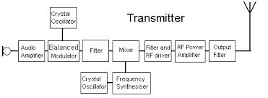
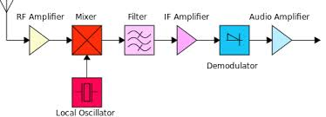
Going Solo – Your First Amateur Radio Transmission
Receiver
4

Slide 5
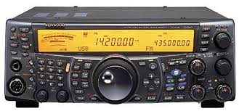
Going Solo – Your First Amateur Radio Transmission
  A keypad or VFO knob can be used to enter the operating frequency on a modern transceiver. T4B02
KeyPad
VFO
5

Slide 6
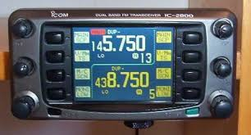
Going Solo – Your First Amateur Radio Transmission
  The squelch control on a transceiver will mute the receiver output noise when no signal is being received. T4B03
2-meter band
70 cm band
Volume control
Volume control
Squelch
Squelch
VFO
VFO
6

Slide 7
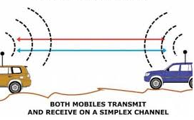
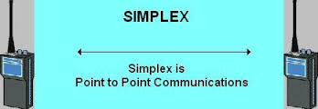
Going Solo – Your First Amateur Radio Transmission
  Simplex communication is the term used to describe an amateur station that is transmitting and receiving on the same frequency. T2A11
  Simplex channels are designated in the VHF/UHF band plan so stations within mutual communications range can communicate without tying up a repeater. T2B12
  When an amateur operator makes on-air transmission to test equipment or antenna, properly identify the transmitting station. T2A06
7

Slide 8
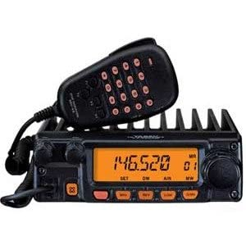
Going Solo – Your First Amateur Radio Transmission
  The scanning function of an FM receiver can scan through a range of frequencies to check for activity. T4B13
8

Slide 9
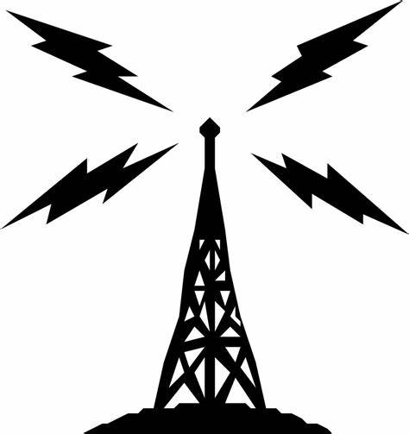
Going Solo – Your First Amateur Radio Transmission
  The procedural signal “CQ” means calling any station. T2A08
  When choosing an operating frequency for calling CQ:
      Listen first to be sure that no one else is using the frequency
      Ask if the frequency is in use
      Make sure you are in your assigned band
        All of these choices are correct. T2A12
9

Slide 10
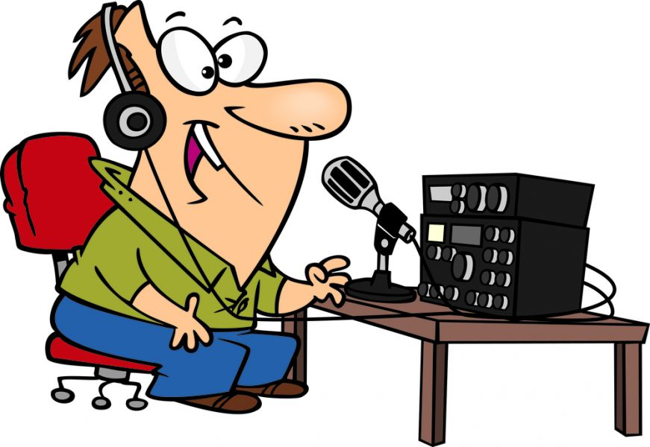
Going Solo – Your First Amateur Radio Transmission
  When responding to a station calling CQ, transmit the other station’s call sign followed by your call sign. T2A05
  An appropriate way to call another station on a repeater if you know the other station’s call sign is to say the station’s call sign then identify with your call sign. T2A04
10

Slide 11
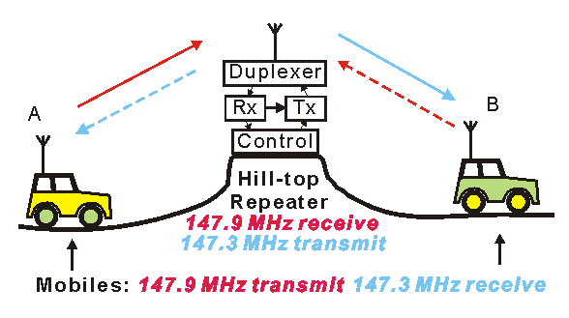
Going Solo – Your First Amateur Radio Transmission
  If another operator reports that your station’s 2 meter signals were strong just a moment ago, but now they are weak or distorted, Try moving a few feet or changing the direction of your antenna if possible, as reflections may be causing multi-path distortion. T3A01
11

Slide 12
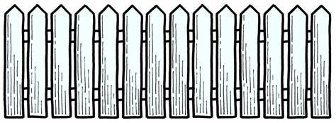
Going Solo – Your First Amateur Radio Transmission
  The rapid fluttering sound sometimes heard from mobile stations that are moving while transmitting is called picket fencing. T3A06
  When two stations transmitting on the same frequency interfere with each other, common courtesy should prevail, but no one has absolute right to an amateur frequency. T2B08
12

Slide 13
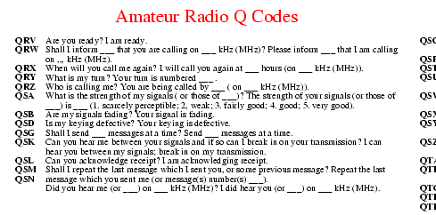
Going Solo – Your First Amateur Radio Transmission
  QRM is the Q signal that indicates you are receiving interference from other stations. T2B10
  QSY is the Q signal that indicates you are changing frequency. T2B11
13

Slide 14
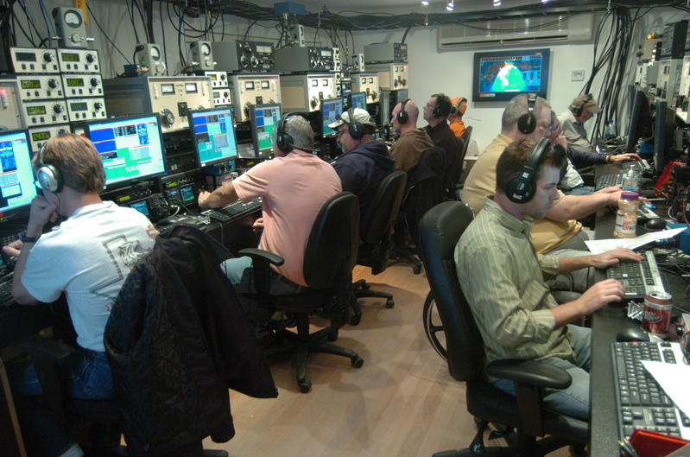
Going Solo – Your First Amateur Radio Transmission
  A popular operating activity that involves contacting as many stations as possible during a specified period of time is called contesting. T8C03
  When contacting another station in a radio contest a good procedure is to send only the minimum information needed for the proper identification and the contest exchange. T8C04
14

Slide 15
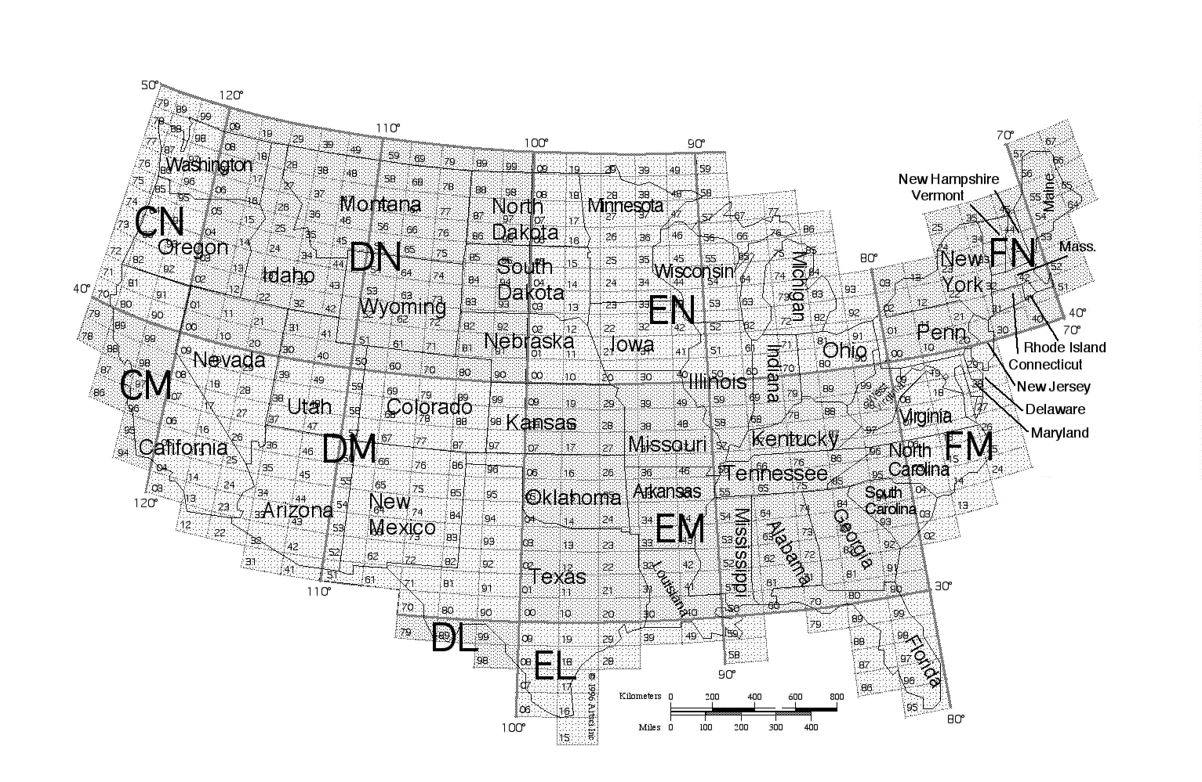
Going Solo – Your First Amateur Radio Transmission
  A Grid locator is a letter-number designator assigned to a geographic location. T8C05
15

Slide 16
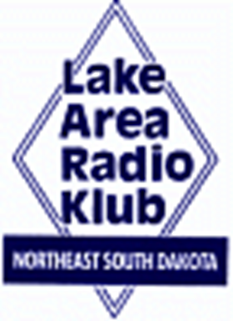

Element 2 Technician Class Question Pool
Going Solo – Your First Amateur Radio Transmission
Valid July 1, 2018
Through
June 30, 2022

Slide 17
T4B02 Which of the following can be used to enter the operating frequency on a modern transceiver?
  The keypad or VFO knob
  The CTCSS or DTMF encoder
  The Automatic Frequency Control
  All of these choices are correct

Slide 18
T4B03 What is the purpose of the squelch control on a transceiver?
  To set the highest level of volume desired
  To set the transmitter power level
  To adjust the automatic gain control
  To mute receiver output noise when no signal is being received

Slide 19
T2B03 Which of the following describes the muting of receiver audio controlled solely by the presence or absence of an RF signal?
Tone squelch
Carrier squelch
CTCSS
Modulated carrier

Slide 20
T2A11 What term describes an amateur station that is transmitting and receiving on the same frequency?
Full duplex
Diplex
Simplex
Multiplex

Slide 21
T2B12 Why are simplex channels designated in the VHF/UHF band plans?
So that stations within mutual communications range can communicate without tying up a repeater
For contest operation
For working DX only
So that stations with simple transmitters can access the repeater without automated offset

Slide 22
T2A06 Which of the following is required when making on-the-air test transmissions?
Identify the transmitting station
Conduct tests only between 10:00 p.m. and 6 a.m. local time
Notify the FCC of the test transmission
All of these choices are correct

Slide 23
T2A08 What is the meaning of the procedural signal "CQ"?
Call on the quarter hour
A new antenna is being tested (no station should answer)
Only the called station should transmit
Calling any station

Slide 24
T2A12 Which of the following is a guideline to use when choosing an operating frequency for calling CQ?
Listen first to be sure that no one else is using the frequency
Ask if the frequency is in use
Make sure you are in your assigned band
All of these choices are correct

Slide 25
T4B13 Which of the following is a use for the scanning function of an FM transceiver?
To check incoming signal deviation
To prevent interference to nearby repeaters
To scan through a range of frequencies to check for activity
To check for messages left on a digital bulletin board

Slide 26
T2A05 How should you respond to a station calling CQ?
Transmit CQ followed by the other station’s call sign
Transmit your call sign followed by the other station’s call sign
Transmit the other station’s call sign followed by your call sign
Transmit a signal report followed by your call sign

Slide 27
T2A04 What is an appropriate way to call another station on a repeater if you know the other station's call sign?
Say break, break then say the station's call sign
Say the station's call sign then identify with your call sign
Say CQ three times then the other station's call sign
Wait for the station to call CQ then answer it

Slide 28
T3A01 What should you do if another operator reports that your station’s 2 meter signals were strong just a moment ago, but now they are weak or distorted?
  Change the batteries in your radio to a different type
  Turn on the CTCSS tone
  Ask the other operator to adjust his squelch control
  Try moving a few feet or changing the direction of your antenna if possible, as reflections may be causing multi-path distortion

Slide 29
T3A06 What term is commonly used to describe the rapid fluttering sound sometimes heard from mobile stations that are moving while transmitting?
  Flip-flopping
  Picket fencing
  Frequency shifting
  Pulsing

Slide 30
T2B08 Which of the following applies when two stations transmitting on the same frequency interfere with each other?
Common courtesy should prevail, but no one has absolute right to an amateur frequency
Whoever has the strongest signal has priority on the frequency
Whoever has been on the frequency the longest has priority on the frequency
The station which has the weakest signal has priority on the frequency

Slide 31
T2B10 Which Q signal indicates that you are receiving interference from other stations?
QRM
QRN
QTH
QSB

Slide 32
T2B11 Which Q signal indicates that you are changing frequency?
QRU
QSY
QSL
QRZ

Slide 33
T8C03 What popular operating activity involves contacting as many stations as possible during a specified period of time?
  Contesting
  Net operations
  Public service events
  Simulated emergency exercises

Slide 34
T8C04 Which of the following is good procedure when contacting another station in a radio contest?
    Be sure to sign only the last two letters of your call if there is a pileup calling the station
    Work the station twice to be sure that you are in his log
    Send only the minimum information needed for proper identification and the contest exchange
    All of these choices are correct

Slide 35
T8C05 What is a grid locator?
  A letter-number designator assigned to a geographic location
  A letter-number designator assigned to an azimuth and elevation
  An instrument for neutralizing a final amplifier
  An instrument for radio direction finding

