Slide 1

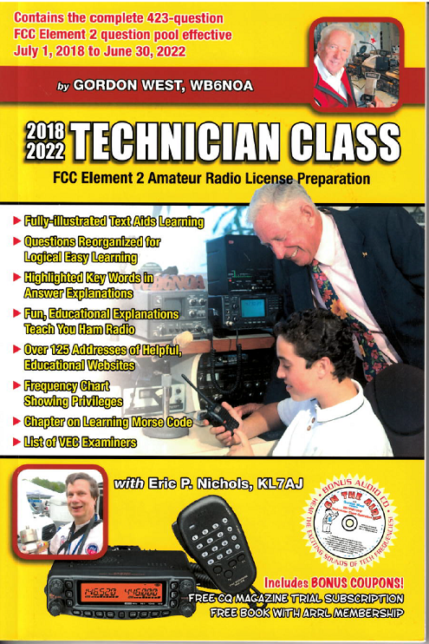
Technician Licensing Class
Repeaters
Valid July 1, 2018
Through
June 30, 2022
Notes:
1

Slide 2
Amateur Radio Technician Class
Element 2 Course Presentation
ELEMENT 2 SUB-ELEMENTS (Groupings)
  About Ham Radio
  Call Signs
  Control
  Mind the Rules
  Tech Frequencies
  Your First Radio
  Going Solo
  Repeaters
  Emergency!
  Weak Signal Propagation
2

Slide 3
Amateur Radio Technician Class
Element 2 Course Presentation
ELEMENT 2 SUB-ELEMENTS (Groupings)
  Talk to Outer Space!
  Your Computer Goes Ham Digital!
  Multi-Mode Radio Excitement
  Run Some Interference Protection
  Electrons – Go With the Flow!
  It’s the Law, per Mr. Ohm!
  Go Picture These!
  Antennas
  Feed Me With Some Good Coax!
  Safety First!
3

Slide 4
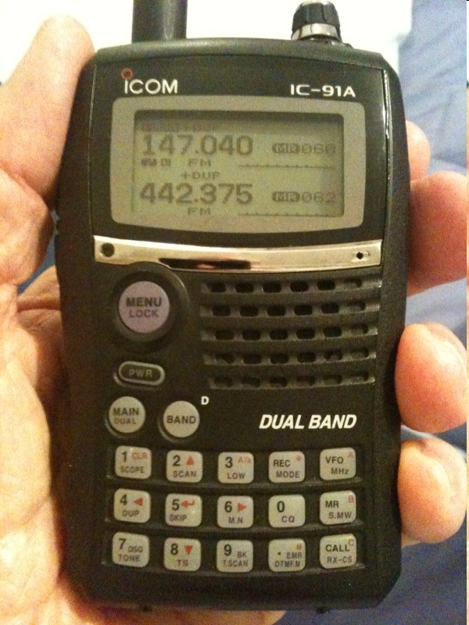
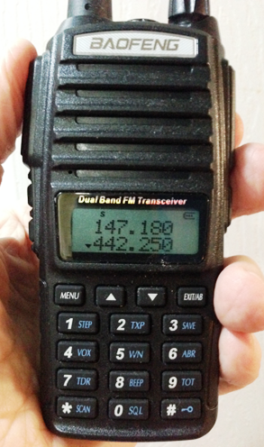
Repeaters
Before you press the PTT switch, LISTEN to make sure the frequency is clear for use.
4

Slide 5
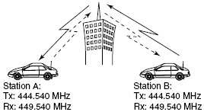
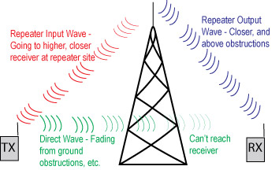
Repeaters
  A repeater station simultaneously retransmits the signal of another amateur station on a different channel or channels. T1F09
5

Slide 6
Repeaters
  Auxiliary, repeater, or space stations can automatically retransmit the signals of other amateur stations. T1D07
  The difference between the repeater’s transmit and receive frequencies is called “repeater offset”. T2A07
Frequency Range Shift Direction
145.200-145.495 MHz Negative
146.610-146.995 MHz Positive
147.000-147.395 Mhz Positive
442.000-444.995 Mhz Positive
447.000-449.995 Mhz Negative
6

Slide 7
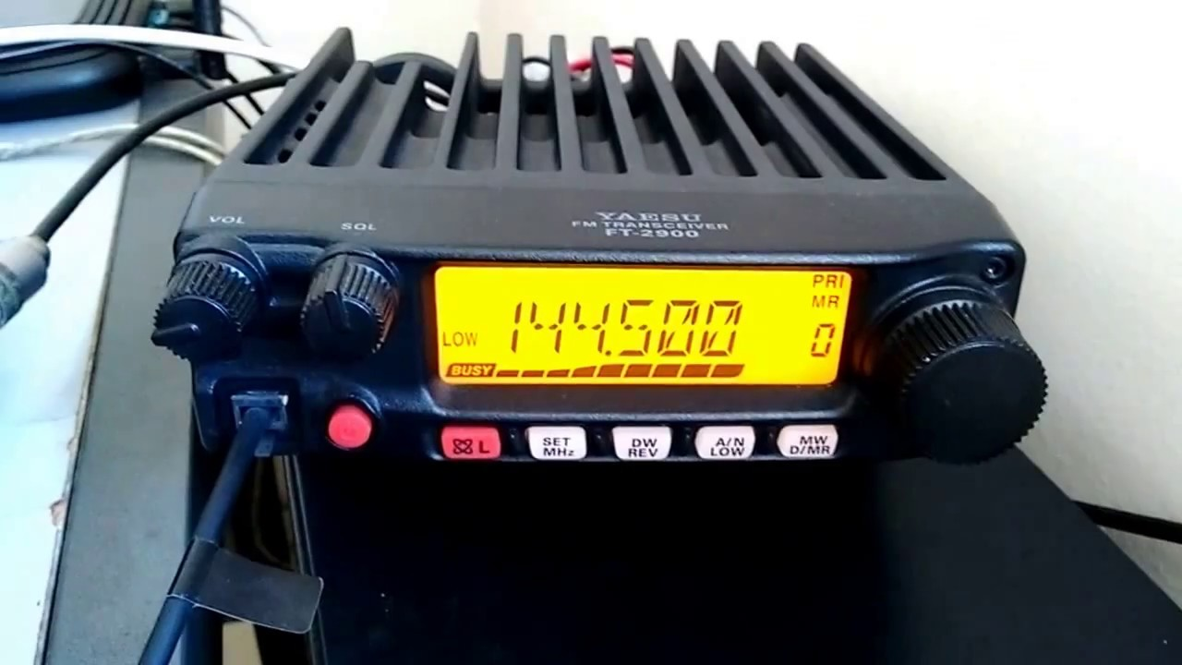
Repeaters
  The most common use of the “reverse split” function of a VHF/UHF transceiver is to listen on a repeater’s input frequency. T2B01
  Listen on the repeater input function might allow you to hear a station not strong enough to keep the repeater’s squelch open. T2B03
7

Slide 8
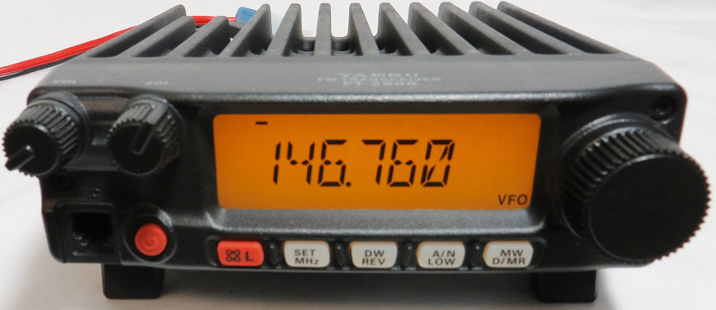
Repeaters
  The most common repeater frequency offset in the 2 meter band is plus or minus 600 kHz. T2A01
  The common repeater frequency offset in the 70 cm band is plus or minus 5 MHz. T2A03
8

Slide 9
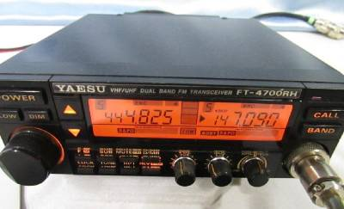
Repeaters
  Common problems that might cause you to be able to hear but not access a repeater even transmitting with the proper offset:
    Improper transceiver offset
    The repeater receiver may require a proper CTCSS tone for access
    The repeater receiver may require a proper DCS tone sequence for access
        All of these choices are correct. T2B04
9

Slide 10
Repeaters
  CTCSS is the term used to describe the use of a sub-audible tone transmitted with normal voice audio to open the squelch of a receiver. T2B02
CTCSS Tones In Use
67.0 Hz 94.8 Hz 131.8 Hz 171.3 Hz 203.5 Hz
69.3 Hz 97.4 Hz 136.5 Hz 173.8 Hz 206.5 Hz
71.9 Hz 100.0 Hz 141.3 Hz 177.3 Hz 210.7 Hz
74.4 Hz 103.5 Hz 146.2 Hz 179.9 Hz 218.1 Hz
77.0 Hz 107.2 Hz 151.4 Hz 183.5 Hz 225.7 Hz
79.7 Hz 110.9 Hz 156.7 Hz 186.2 Hz 229.1 Hz
82.5 Hz 114.8 Hz 159.8 Hz 189.9 Hz 233.6 Hz
85.4 Hz 118.8 Hz 162.2 Hz 192.8 Hz 241.8 Hz
88.5 Hz 123.0 Hz 165.5 Hz 196.6 Hz 250.3 Hz
91.5 Hz 127.3 Hz 167.9 Hz 199.5 Hz 254.1 Hz
10

Slide 11
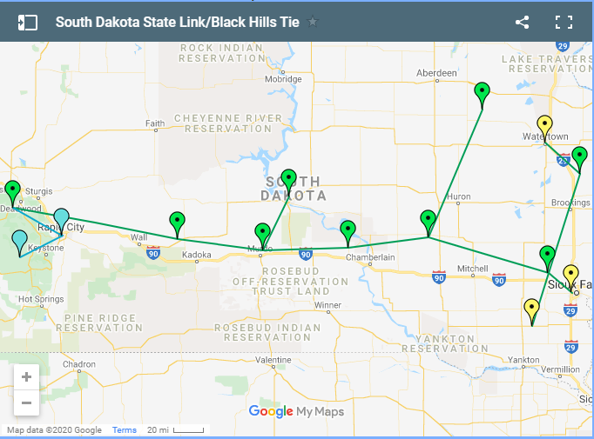
Repeaters
  Your call sign is the brief statement often transmitted in place of CQ to indicate that you are listening to a repeater. T2A09
  A linked repeater network is a network of repeaters where one signals received by one repeater are repeated by all the repeaters. T2B14
11

Slide 12
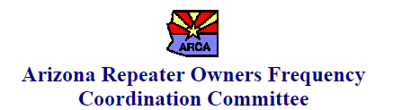
Repeaters
  The volunteer frequency coordinator recognized by local amateurs recommends transmit and receive channels and other parameters for auxiliary and repeater stations. T1A08
  Frequency coordinators are selected by amateur operators in a local or regional area whose stations are eligible to be auxiliary or repeater stations. T1A09
12

Slide 13
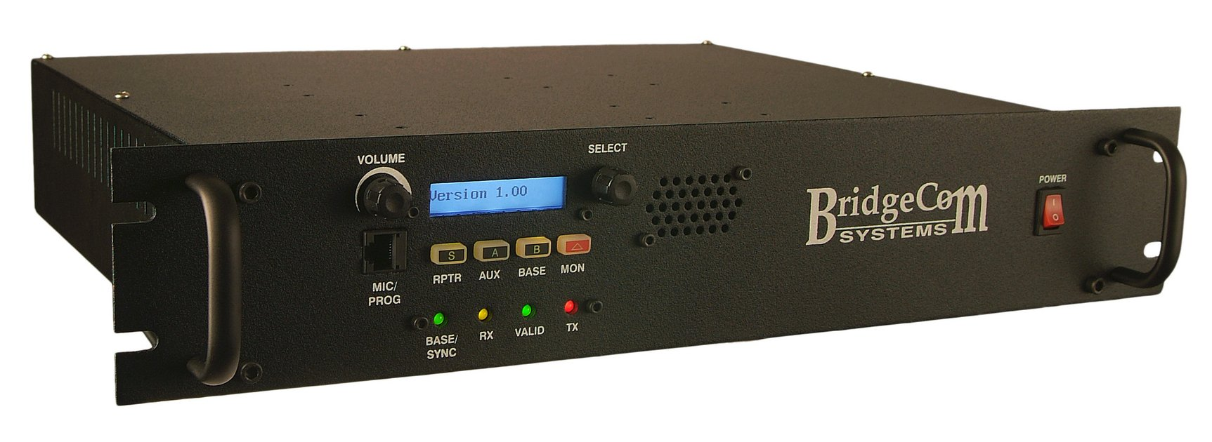
Repeaters
  Sending the call sign using CW or phone emission is the method of call sign identification required for a station transmitting phone signals. T1F05
13

Slide 14
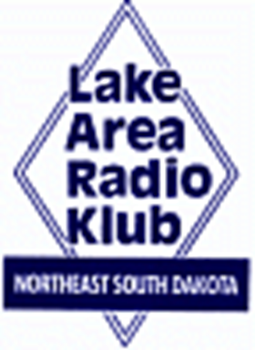
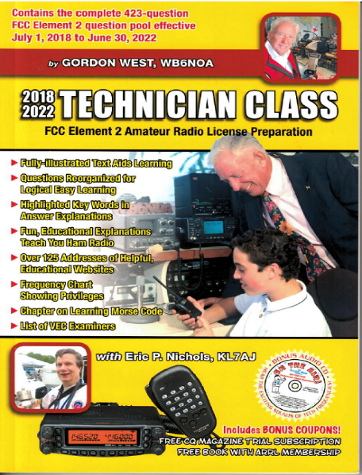
Element 2 Technician Class Question Pool
Repeaters
Valid July 1, 2018
Through
June 30, 2022

Slide 15
T1F09 What type of amateur station simultaneously retransmits the signal of another amateur station on a different channel or channels?
Beacon station
Earth station
Repeater station
Message forwarding station

Slide 16
T1D07 What types of amateur stations can automatically retransmit the signals of other amateur stations?
Auxiliary, beacon, or Earth station
Repeater, auxiliary, or space station
Beacon, repeater, or space station
Earth, repeater, or space station

Slide 17
T2A07 What is meant by “repeater offset”?
  The difference between the repeater’s transmit frequency and receive frequency
  The repeater has a time delay to prevent interference
  The repeater station identification is done on a separate frequency
  The number of simultaneous transmit frequencies used by a repeater

Slide 18
T2B01 What is the most common use of the “reverse split” function of a VHF/UHF transceiver?
Reduce power output
Increase power output
Listen on a repeater’s input frequency
Listen on a repeater’s output frequency

Slide 19
T2B03 If a station is not strong enough to keep a repeater’s receiver squelch open, which of the following might allow you to receive the station’s signal?
  Open the squelch on your radio
  Listen on the repeater input frequency
  Listen on the repeater output frequency
  Increase your transmit power

Slide 20
T2A01 Which of the following is a common repeater frequency offset in the 2 meter band?
  Plus or minus 5 MHz
  Plus or minus 600 kHz
  Plus or minus 500 kHz
  Plus or minus 1 MHz

Slide 21
T2A03 What is a common repeater frequency offset in the 70 cm band?
Plus or minus 5 MHz
Plus or minus 600 kHz
Plus or minus 500 kHz
Plus or minus 1 MHz

Slide 22
T2B04 Which of the following common problems might cause you to be able to hear but not access a repeater even when transmitting with the proper offset?
Improper transceiver offset
The repeater receiver may require a proper CTCSS tone for access
The repeater receiver may require a proper DCS tone sequence for access
All of these choices are correct

Slide 23
T2B02 What term describes the use of a sub-audible tone transmitted along with normal voice audio to open the squelch of a receiver?
Carrier squelch
Tone burst
DTMF
CTCSS

Slide 24
T2A09 What brief statement is often transmitted in place of "CQ" to indicate that you are listening on a repeater?
The words "Hello test" followed by your call sign
Your call sign
The repeater call sign followed by your call sign
The letters "QSY" followed by your call sign

Slide 25
T2B14 Which of the following describes a linked repeater network?
A network of repeaters where signals received by one repeater are repeated by all the repeaters
A repeater with more than one receiver
Multiple repeaters with the same owner
A system of repeaters linked by APRS

Slide 26
T1A08 Which of the following entities recommends transmit/receive channels and other parameters for auxiliary and repeater stations?
Frequency Spectrum Manager appointed by FCC
Volunteer Frequency Coordinator recognized by local amateurs
FCC Regional Field Office
International Telecommunications Union

Slide 27
T1A09 Who selects a frequency coordinator?
The FCC Office of Spectrum Management and Coordination Policy
The local chapter of the Office of National Council of Independent Frequency Coordinators
Amateur operators in a local or regional area whose stations are eligible to be auxiliary or repeater stations
Regional field Office

Slide 28
T1F05 What method of call sign identification is required for a station transmitting phone signals?
Send the call sign followed by the indicator RPT
Send the call sign using CW or phone emission
Send the call sign followed by the indicator R
Send the call sign using only phone emission

