Slide 1

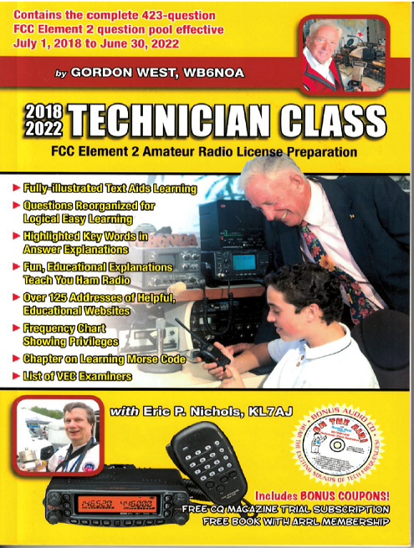
Technician Licensing Class
Emergency
Valid July 1, 2018
Through
June 30, 2022
Notes:
1

Slide 2
Amateur Radio Technician Class
Element 2 Course Presentation
ELEMENT 2 SUB-ELEMENTS (Groupings)
  About Ham Radio
  Call Signs
  Control
  Mind the Rules
  Tech Frequencies
  Your First Radio
  Going Solo
  Repeaters
  Emergency!
  Weak Signal Propagation
2

Slide 3
Amateur Radio Technician Class
Element 2 Course Presentation
ELEMENT 2 SUB-ELEMENTS (Groupings)
  Talk to Outer Space!
  Your Computer Goes Ham Digital!
  Multi-Mode Radio Excitement
  Run Some Interference Protection
  Electrons – Go With the Flow!
  It’s the Law, per Mr. Ohm!
  Go Picture These!
  Antennas
  Feed Me With Some Good Coax!
  Safety First!
3

Slide 4
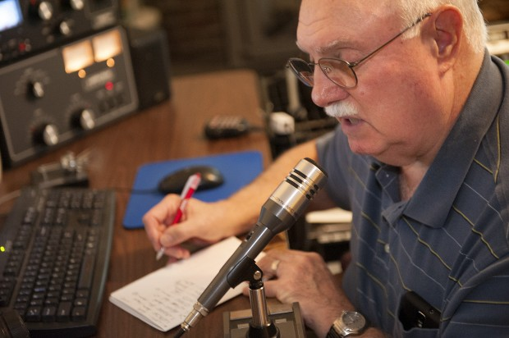
Emergency!
  An accepted practice to get the immediate attention of a net control station when reporting an emergency is to begin your transmission by saying “Priority” or “Emergency” followed by your call sign. T2C06
4

Slide 5

Emergency!
  An accepted practice for an amateur operator who has checked into an emergency traffic net is to remain on frequency without transmitting until asked to do so by the net control station. T2C07
  There never is a situation when FCC rules do not apply to the operation of an amateur station. T2C01
5

Slide 6

Emergency!
  Radio Amateur Civil Emergency Service (RACES):
      A radio service using amateur
      frequencies for emergency
      management of civil defense
      communications;
      A radio service using amateur
      stations for emergency an
      management or civil defense
      communications;
      An emergency service using amateur operators certified by a civil defense organization as being enrolled in that organization.
        All of these choices are correct T1A10
6

Slide 7
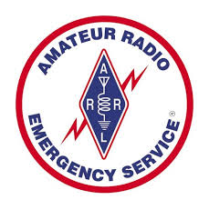
Emergency!
  Licensed amateurs who have
  voluntarily registered their
  qualifications and equipment
  for communications duty in
  the public service are members
  of the Amateur radio Emergency
  Service (ARES). T2C12
7

Slide 8
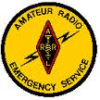
Emergency!
  Both RACES and ARES organizations may provide communications during emergencies. T2C04
  Amateur station control operators are permitted to operate outside the frequency privileges of their license class but only if necessary in situations involving the immediate safety of human life or protection of property. T2C09
8

Slide 9
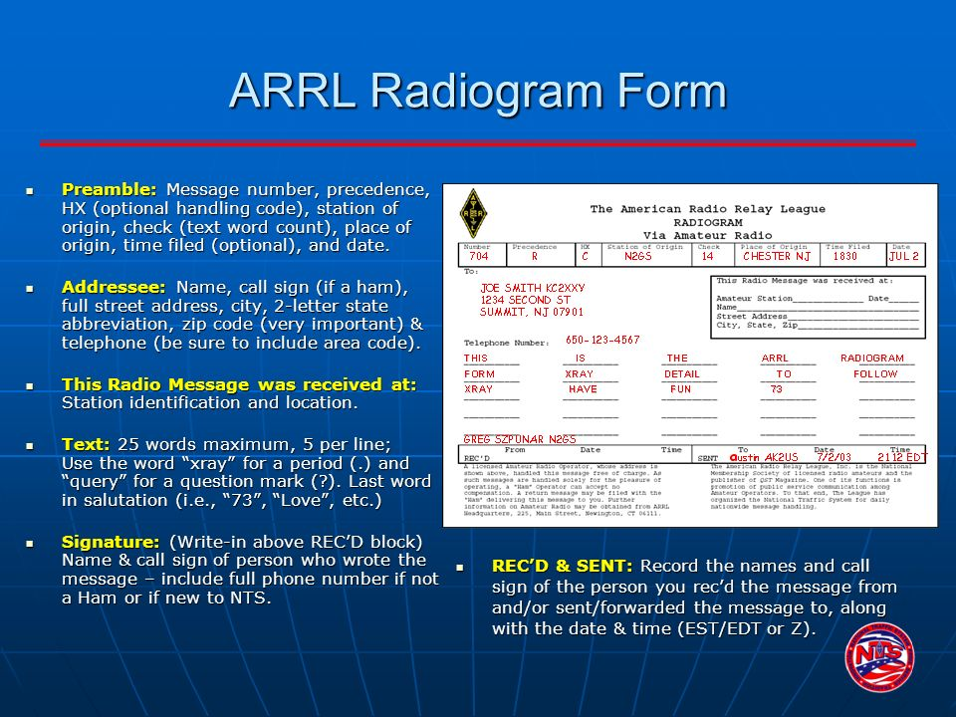
Emergency!
  The term “NCS” stands for Net Control Station. T2C02
  Traffic is formal messages exchanged by net stations. T2C05
9

Slide 10
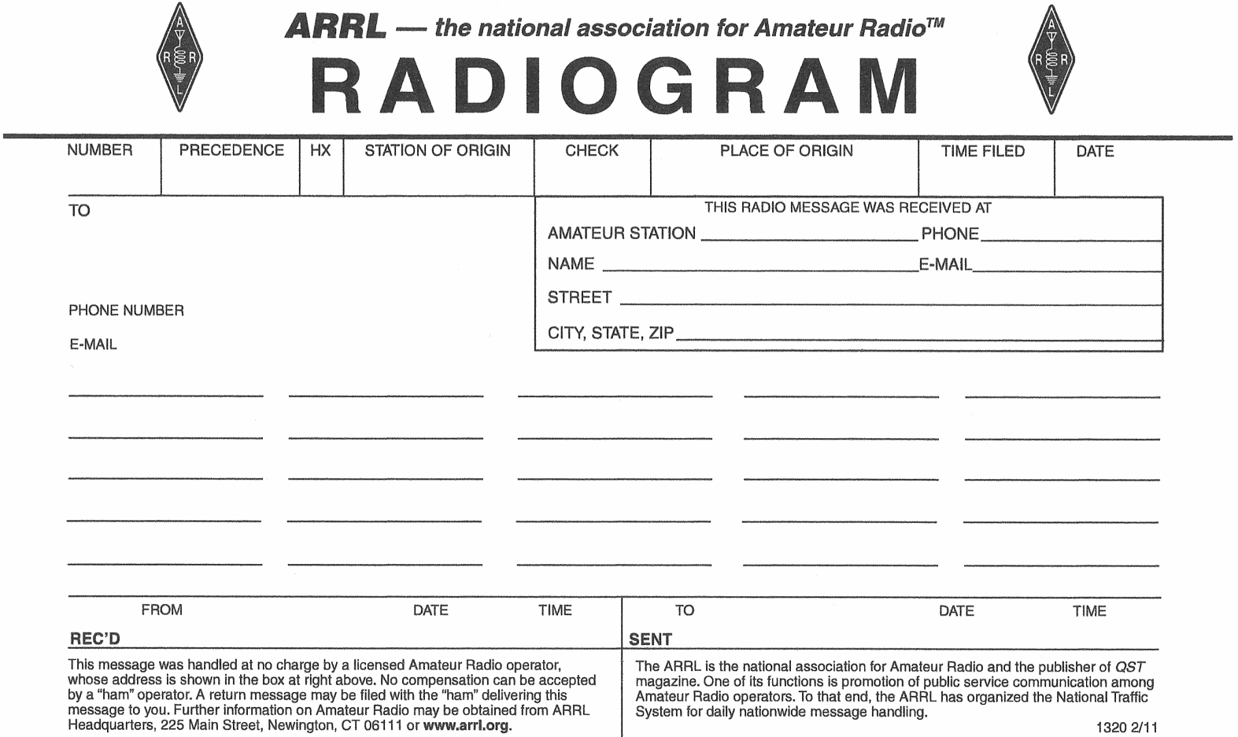
Emergency!
  The preamble in a format traffic message contains information needed to track the message as it passes through the amateur radio traffic handling system. T2C10
10

Slide 11
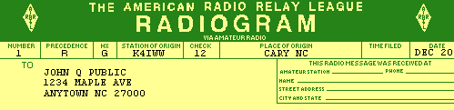
Emergency!
  A characteristic of good emergency traffic handling is passing messages exactly as received. T2C08
  The term “check” in reference to a formal traffic message is a count of the number of words or word equivalents in the text portion of the message. T2C11
11

Slide 12
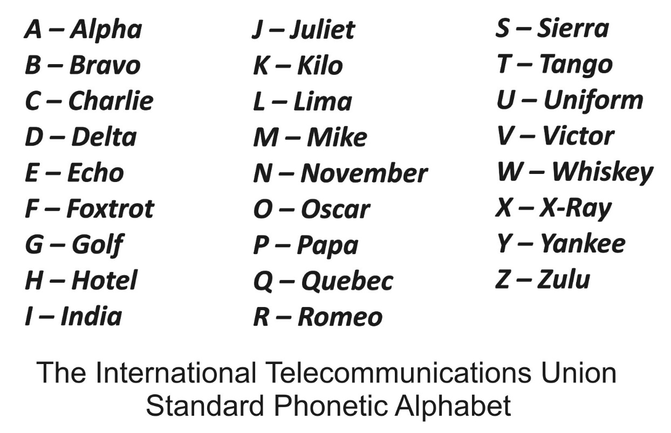
Emergency!
  To insure that voice message traffic containing proper names and unusual words are copied correctly by the receiving station, such words and terms should be spelled out using a standard phonetic alphabet. T2C03
12

Slide 13
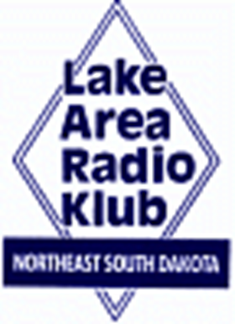
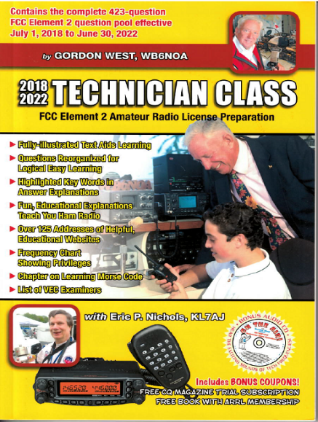
Element 2 Technician Class Question Pool
Emergency!
Valid July 1, 2018
Through
June 30, 2022

Slide 14
T2C06 Which of the following is an accepted practice to get the immediate attention of the net control station when reporting an emergency?
Repeat the words SOS three times followed by the call sign of the reporting station
Press the push-to-talk button three times
Begin your transmission by saying “Priority” or “Emergency” followed by your call sign
Play a pre-recorded emergency alert tone followed by your call sign

Slide 15
T2C07 Which of the following is an accepted practice for an amateur operator who has checked into a net?
Provided that the frequency is quiet, announce the station call sign and location every 5 minutes
Move 5 kHz away from the net's frequency and use high power to ask other hams to keep clear of the net frequency
Remain on frequency without transmitting until asked to do so by the net control station
All of the choices are correct

Slide 16
T2C01 When do the FCC rules NOT apply to the operation of an amateur radio station?
When operating a RACES station
When operating under special FEMA rules
When operating under special ARES rules
Never, FCC rules always apply

Slide 17
T1A10 Which of the following describes the Radio Amateur Civil Emergency Service (RACES)?
A radio service using amateur frequencies for emergency management or civil defense communications
A radio service using amateur stations for emergency management or civil defense communications
An emergency service using amateur operators certified by a civil defense organization as being enrolled in that organization
All of these choices is correct

Slide 18
T2C12 What is the Amateur Radio Emergency Service (ARES)?
Licensed amateurs who have voluntarily registered their qualifications and equipment for communications duty in the public service
Licensed amateurs who are members of the military and who voluntarily agreed to provide message handling services in the case of an emergency
A training program that provides licensing courses for those interested in obtaining an amateur license to use during emergencies
A training program that certifies amateur operators for membership in the Radio Amateur Civil Emergency Service

Slide 19
T2C04 What do RACES and ARES have in common?
They represent the two largest ham clubs in the United States
Both organizations broadcast road and weather information
Neither may handle emergency traffic supporting public service agencies
Both organizations may provide communications during emergencies

Slide 20
T2C09 Are amateur station control operators ever permitted to operate outside the frequency privileges of their license class?
No
Yes, but only when part of a FEMA emergency plan
Yes, but only when part of a RACES emergency plan
Yes, but only if necessary in situations involving the immediate safety of human life or protection of property

Slide 21
T2C02 What is meant by the term “NCS” used in net operation?
Nominal Control System
Net Control Station
National Communications Standard
Normal Communications Syntax

Slide 22
T2C05 What does the term “traffic” refer to in net operation?
Formal messages exchanged by net stations
The number of stations checking in and out of a net
Operation by mobile or portable stations
Requests to activate the net by a served agency

Slide 23
T2C10 What is the preamble in a formal traffic message?
The first paragraph of the message text
The message number
The priority handling indicator for the message
The information needed to track the message as it passes through the amateur radio traffic handling system

Slide 24
T2C08 Which of the following is a characteristic of good emergency traffic handling?
Passing messages exactly as received
Making decisions as whether or not messages should be relayed or delivered
Communicating messages to the news media for broadcast outside the disaster area
All of these choices are correct

Slide 25
T2C03 What should be done when using voice modes to ensure that voice messages containing unusal words are received correctly?
Send the words by voice and Morse code
Speak very loudly into the microphone
Spell the words using a standard phonetic alphabet
All of these choices are correct

Slide 26
T2C11 What is meant by the term "check" in reference to a formal traffic message?
The number of words or word equivalents in the text portion of the message
The value of a money order attached to the message
A list of stations that have relayed the message
A box on the message form that indicates that the message was received and/or relayed

