Slide 1

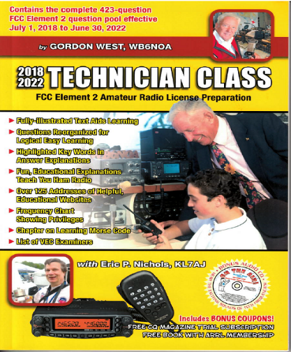
Technician Licensing Class
Weak Signal Propagation
Valid July 1, 2018
Through
June 30, 2022
Notes:
1

Slide 2
Amateur Radio Technician Class
Element 2 Course Presentation
ELEMENT 2 SUB-ELEMENTS (Groupings)
  About Ham Radio
  Call Signs
  Control
  Mind the Rules
  Tech Frequencies
  Your First Radio
  Going Solo
  Repeaters
  Emergency!
  Weak Signal Propagation
2

Slide 3
Amateur Radio Technician Class
Element 2 Course Presentation
ELEMENT 2 SUB-ELEMENTS (Groupings)
  Talk to Outer Space!
  Your Computer Goes Ham Digital!
  Multi-Mode Radio Excitement
  Run Some Interference Protection
  Electrons – Go With the Flow!
  It’s the Law, per Mr. Ohm!
  Go Picture These!
  Antennas
  Feed Me With Some Good Coax!
  Safety First!
3

Slide 4
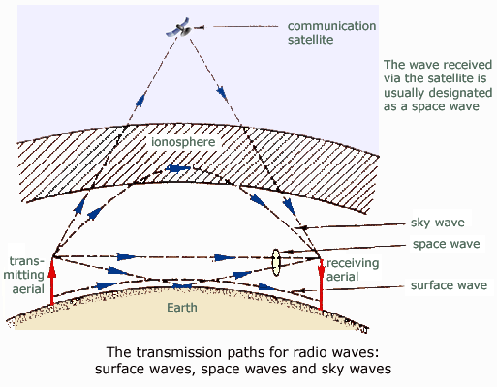
Weak Signal Propagation
  VHF and UHF radio signals
  usually travel somewhat
  farther than the visual line
  of sight distance between
  two stations due to the earth
  seems less curved to radio
  waves than to light. T3C11
  Due to UHF frequencies
  signals not usually being
  refracted by the ionosphere,
  directUHF signals are rarely
  heard from stations outside
  your local coverage area. T3C01
4

Slide 5
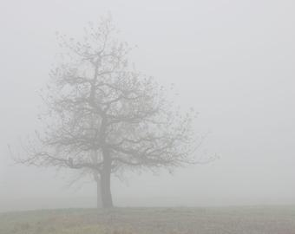
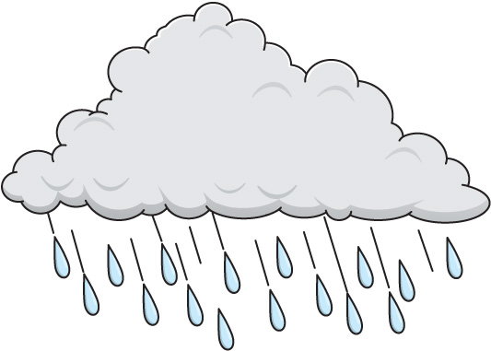
Weak Signal Propagation
  UHF radio signals may travel farther in winter due to less absorption by vegetation. T3A02
      They don’t call it sap for nothing ☺
  Fog and rain have little effect on the 10 an 6 meter bands. T3A12
5

Slide 6
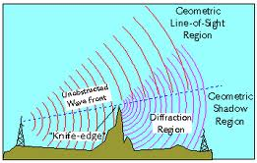
Weak Signal Propagation
  Knife-edge diffraction effects might cause radio signals to be heard despite obstructions between transmitting and receiving stations. T3C05
6

Slide 7
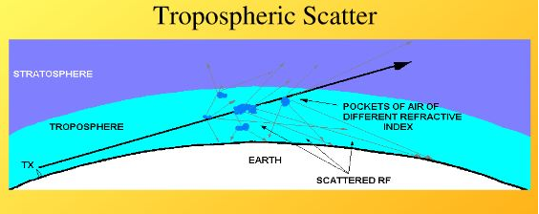
Weak Signal Propagation
  Tropospheric scatter is responsible for allowing over-the-horizon VHF and UHF communications to ranges of approximately 300 miles on a regular basis. T3C06
7

Slide 8
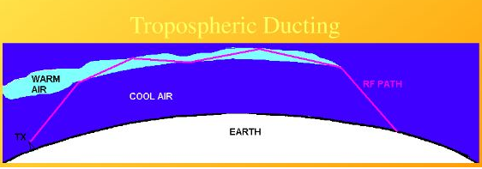
Weak Signal Propagation
  Rain can decrease range at microwave frequencies. T3A13
  Temperature inversions in the atmosphere cause tropospheric ducting. T3C08
8

Slide 9
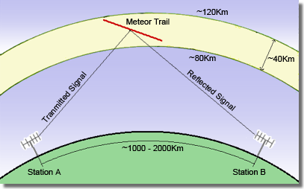
Weak Signal Propagation
  A characteristic of VHF signals received via auroral reflection exhibits rapid fluctuations of strength and often sound distorted. T3C03
  The 6 meter band is
  best suited for
  communicating via
  meteor scatter. T3C07
9

Slide 10
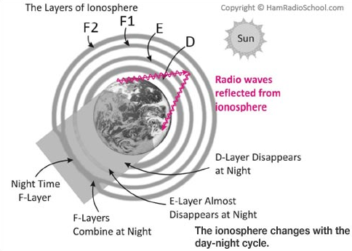
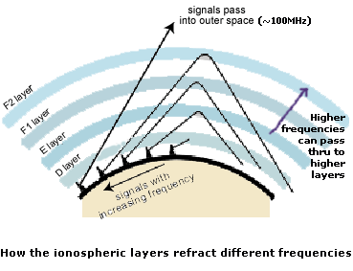
Weak Signal Propagation
  The ionosphere is the part of the atmosphere that enables the propagation of radio signals around the world. T3A11
  The only HF band where Technician class operators have phone privileges is 10 meters. T1B06
10

Slide 11
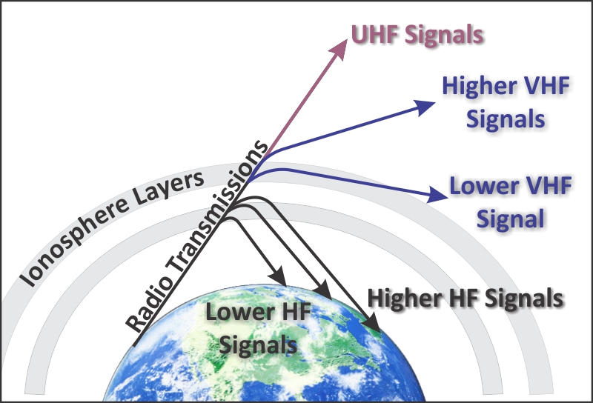
Weak Signal Propagation
  One advantage of HF vs VHF and higher frequencies is long distance ionospheric propagation is far more common on HF. T3C02
11

Slide 12
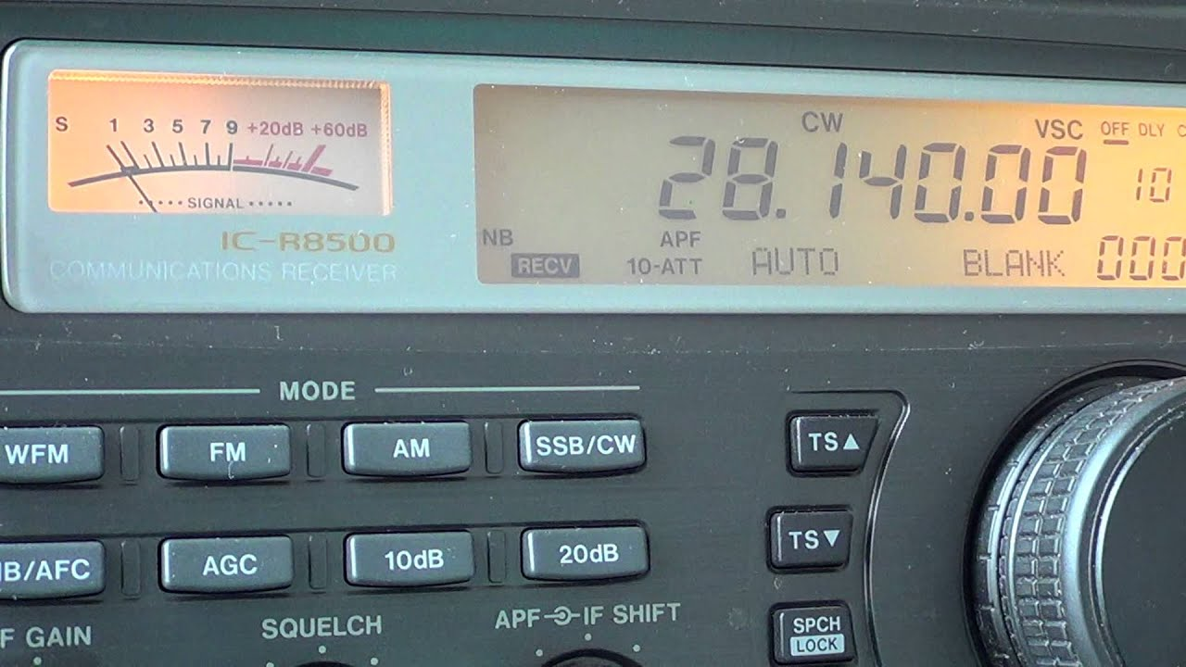
Weak Signal Propagation
  10 meters is the only HF band where technician class operators have frequencies available for RTTY and data transmissions. T1B10
  A ‘beacon’ is an amateur station transmitting communications for the purpose of observing propagation or related experimental activities. T1A06
12

Slide 13
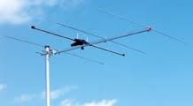
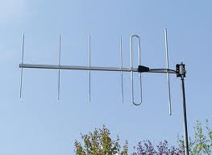
Weak Signal Propagation
  From dawn to shortly after sunset during periods of high sunspot activity is generally the best time for long-distance 10 meter band propagation via the F layer. T3C09
  Skip signals refracted from the ionosphere are elliptically polarized and can be received with either a vertically or horizontally polarized antenna. T3A09
13

Slide 14
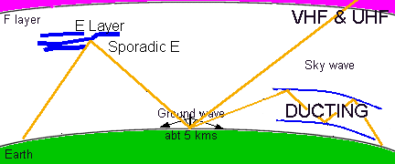
Weak Signal Propagation
  Sporadic E skip is most commonly associated with occasional strong over-the-horizon signals on the 10, 6, and 2 meter bands. T3C04
  6 or 10 meters may provide long distance communications during the peak of the sunspot cycle. T3C10
14

Slide 15
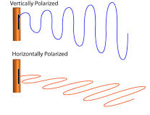
Weak Signal Propagation
  The orientation of the electric field
  of a radio wave is used to describe
  its polarization. T3B02
  Random combining of signals arriving via different paths is a likely cause of irregular fading of signals received by ionospheric reflection. T3A08
15

Slide 16


Element 2 Technician Class Question Pool
Weak Signal Propagation
Valid July 1, 2018
Through
June 30, 2022

Slide 17
T3C11 Why do VHF and UHF radio signals usually travel somewhat farther than the visual line of sight distance between two stations?
  Radio signals move somewhat faster than the speed of light
  Radio waves are not blocked by dust particles
  The Earth seems less curved to radio waves than to light
  Radio waves are blocked by dust particles

Slide 18
T3A02 Why might the range of VHF and UHF signals be better in winter?
  Less ionospheric absorbtion
  Less absorption by vegetation
  Less solar activity
  Less tropospheric absorbtion

Slide 19
T3A12 How might fog and light rain affect radio range on the 10 meter and 6 meter bands?
  Fog and rain absorb these wavelength bands
  Fog and rain will have little effect on these bands
  Fog and rain will deflect these signals
  Fog and rain will increase radio range

Slide 20
T3C01 Why are direct (not via a repeater) UHF signals rarely heard from stations outside your local coverage area?
  They are too weak to go very far
  FCC regulations prohibit them from going more than 50 miles
  UHF signals are usually not reflected by the ionosphere
  They collide with trees and shrubbery and fade out

Slide 21
T3C05 Which of the following effects might cause radio signals to be heard despite obstructions between the transmitting and receiving stations?
  knife-edge diffraction
  Faraday rotation
  Quantum tunneling
  Doppler shift

Slide 22
T3C06 What mode is responsible for allowing over-the- horizon VHF and UHF communications to ranges of approximately 300 miles on a regular basis?
  Tropospheric ducting
  D layer refraction
  F2 layer refraction
  Faraday rotation

Slide 23
T3C08 What causes tropospheric ducting?
  Discharges of lightning during electrical storms
  Sunspots and solar flares
  Updrafts from hurricanes and tornadoes
  Temperature inversions in the atmosphere

Slide 24
T3A13 What weather condition would decrease range at microwave frequencies?
  High winds
  Low barometric pressure
  Precipitation
  Colder temperatures

Slide 25
T3C03 What is a characteristic of VHF signals received via auroral reflection?
  Signals from distances of 10,000 or more miles are common
  The signals exhibit rapid fluctuations of strength and often sound distorted
  These types of signals occur only during winter nighttime hours
  These types of signals are generally strongest when your antenna is aimed west

Slide 26
T3C07 What band is best suited to communicating via meteor scatter?
  10 meters
  6 meters
  2 meters
  70 cm

Slide 27
T3A11 Which part of the atmosphere enables the propagation of radio signals around the world?
  The stratosphere
  The troposphere
  The ionosphere
  The magnetosphere

Slide 28
T1B06 On which HF bands does a Technician class operator have phone privleges?
  None
  10 meter band only
  80 meter, 40 meter, 15 meter and 10 meter bands
  30 meter band only

Slide 29
T3C02 Which of the following is an advantage of HF vs VHF and higher frequencies?
HF Antennas are generally smaller
HF accommodates wider bandwidth signals
Long distance ionospheric propagation is far more common on HF
There is less atmospheric interference (static) on HF

Slide 30
T1B10 Which of the following bands have frequencies available to the Technician class operator for RTTY and data transmissions?
10 meter, 12 meter, 17 meter, and 40 meter bands
10 meter, 15 meter, 40 meter, and 80 meter bands
30 meter band only
10 meter band only

Slide 31
T1A06 What is the FCC Part 97 definition of a beacon?
A government transmitter marking the Amateur Radio band edges
A bulletin sent by the FCC to announce a national emergency
An amateur station transmitting communications for the purposes of observing propagation or related experimental activities.
A continuous transmission of weather information authorized in the amateur bands by the National Weather Service

Slide 32
T3C09 What is generally the best time for long-distance 10 meter band propagation via the F layer?
  From dawn to shortly after sunset during periods of high sunspot activity
  From shortly after sunset to dawn during periods of high sunspot activity
  From dawn to shortly after sunset during periods of low sunspot activity
  From shortly after sunset to dawn during periods of low sunspot activity

Slide 33
T3A09 Which of the following results from the fact that skip signals refracted from the ionosphere are elliptically polarized?
  Digital modes are unusable
  Either vertically or horizontally polarized antennas may be used for transmission or reception
  FM voice is unusable
  Both the transmitting and receiving antennas must be of the same polarization

Slide 34
T3C04 Which of the following propagation types is most commonly associated with occasional strong over- the-horizon signals on the 10, 6, and 2 meter bands?
  Backscatter
  Sporadic E
  D layer absorption
  Gray-line propagation

Slide 35
T3C10 Which of the following bands may provide long distance communications during the peak of the sunspot cycle ?
  Six or ten meter band
  23 centimeter band
  70 centimeters or 1.25 meters bands
  All of these choices are correct

Slide 36
T3B02 What property of a radio wave is used to describe its polarization?
  The orientation of the electric field
  The orientation of the magnetic field
  The ratio of the energy in the magnetic field to the energy in the electric field
  The ratio of the velocity to the wavelength

Slide 37
T3A08 Which of the following is a likely cause of irregular fading of signals received by ionospheric reflection?
  Frequency shift due to Faraday rotation
  Interference from thunderstorms
  Random combining of signals arriving via different path lengths
  Intermodulation distortion

