Slide 1

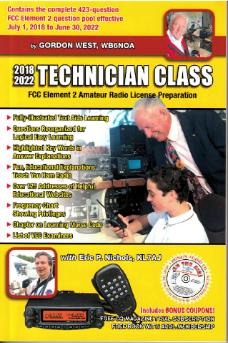
Technician Licensing Class
Run Some Interference Protection
Valid July 1, 2018
Through
June 30, 2022
Notes:
1

Slide 2
Amateur Radio Technician Class
Element 2 Course Presentation
ELEMENT 2 SUB-ELEMENTS (Groupings)
  About Ham Radio
  Call Signs
  Control
  Mind the Rules
  Tech Frequencies
  Your First Radio
  Going On The Air!
  Repeaters
  Emergency!
  Weak Signal Propagation
2

Slide 3
Amateur Radio Technician Class
Element 2 Course Presentation
ELEMENT 2 SUB-ELEMENTS (Groupings)
  Talk to Outer Space!
  Your Computer Goes Ham Digital!
  Multi-Mode Radio Excitement
  Run Some Interference Protection
  Electrons – Go With the Flow!
  It’s the Law, per Mr. Ohm!
  Go Picture These!
  Antennas
  Feed Me With Some Good Coax!
  Safety First!
3

Slide 4
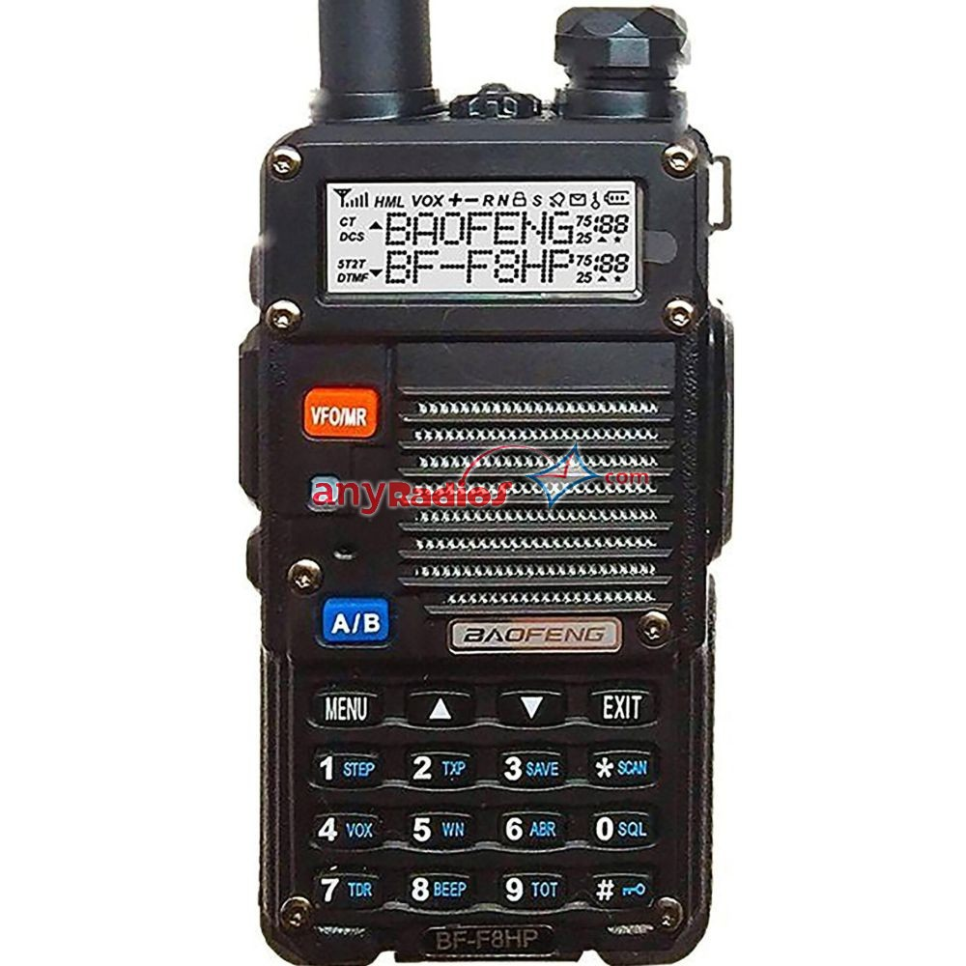
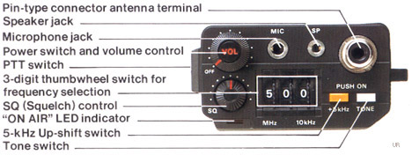
Run Some Interference Protection
  Possible problems if you receive a report that your audio signal through the repeater is distorted or unintelligible.
    Your transmitter may be slightly off frequency;
    Your batteries may be running low;
    You could be in a bad location;
        All of these choices are correct. T7B10
4

Slide 5
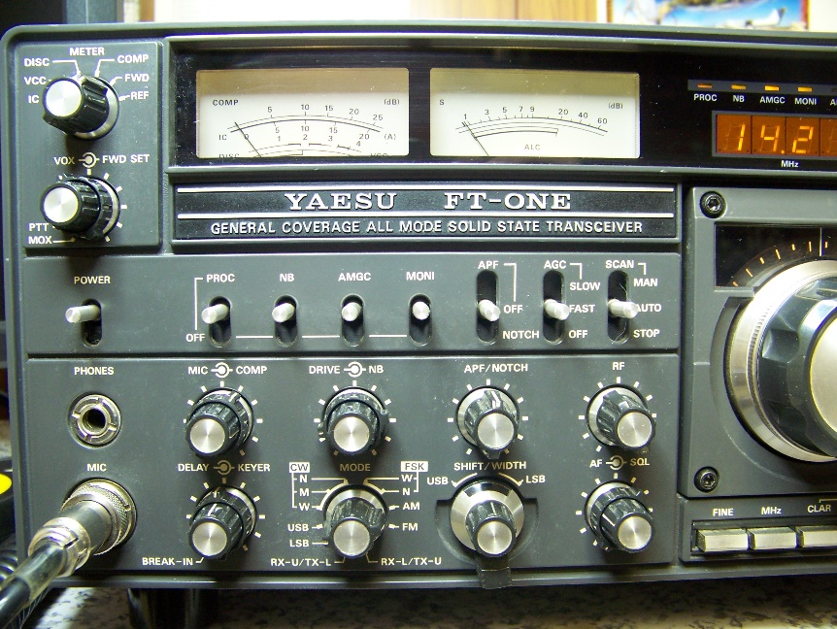
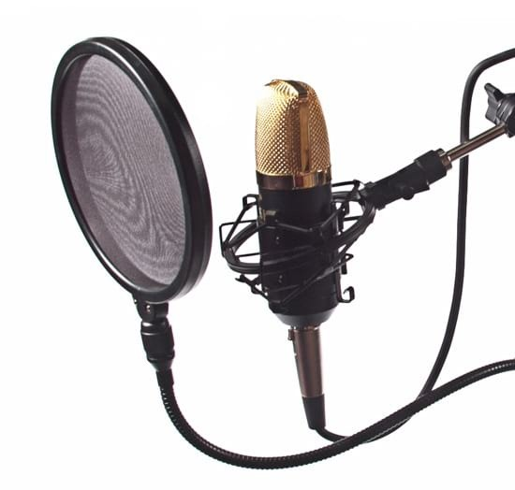
Run Some Interference Protection
  If a transmitter is operated with the microphone gain set too high the output signal might become distorted T4B01
  Talk farther away from the microphone if you are told your FM handheld or mobile transceiver is over-deviating. T7B01
5

Slide 6
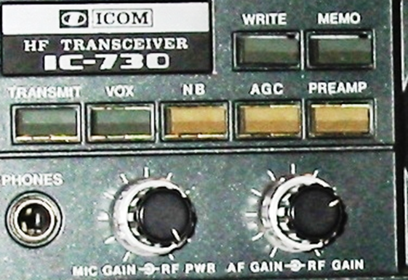
Run Some Interference Protection
  If you are breaking up on voice peaks through a repeater you are talking too loudly. T2B05
  To reduce ignition interference to a receiver turn on the noise blanker. T4B05
  A noise blanker is used to remove power line or ignition noise. T4B12
    Not on common FM handheld or mobile FM radios.
    On bigger high-frequency, multi-mode transceiver.
PreAmp built in
NB – Noise Blanker
6

Slide 7
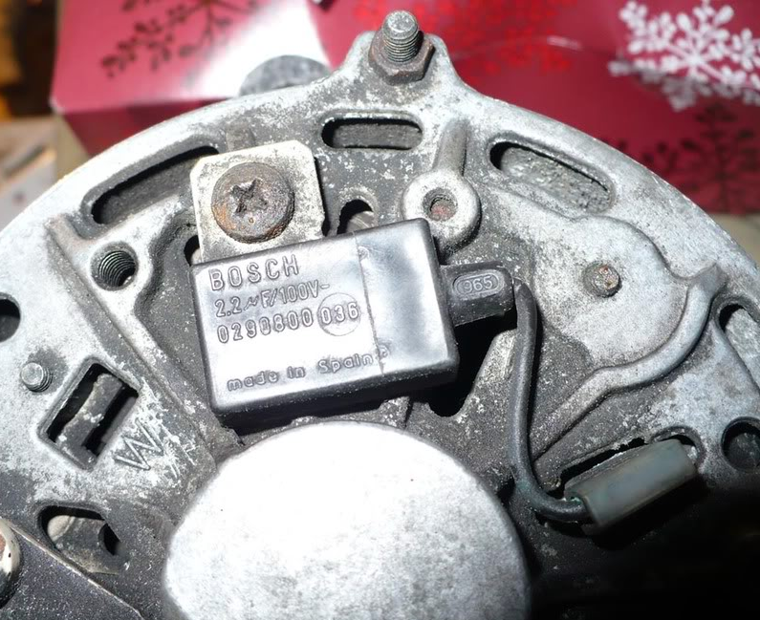
Run Some Interference Protection
  A source of a high-pitched
  whine that varies with
  engine speed in a mobile
  transceiver’s receive audio
  is the alternator. T4A10
7

Slide 8
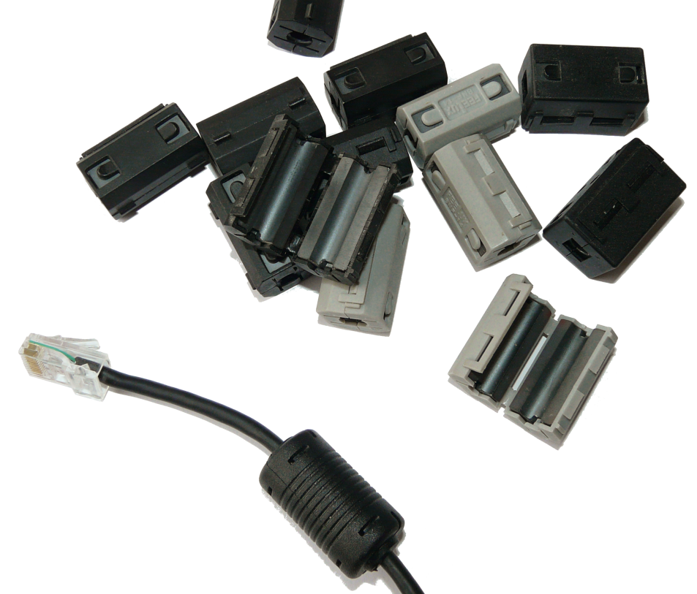
Run Some Interference Protection
  Use a ferrite choke to
  cure distorted audio
  caused by RF current
  flowing on the shield
  of a microphone cable. T4A09
  Be sure all TV coaxial connectors are installed properly as the first step to resolve cable TV interference from your ham radio transmission. T7B12
8

Slide 9
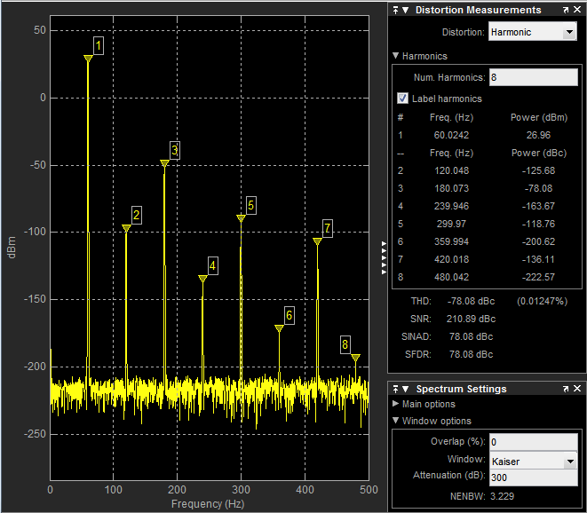
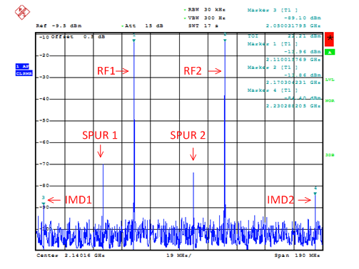
Run Some Interference Protection
  Causes of radio frequency interference:
    Fundamental overload;
    Harmonics;
    Spurious emissions;
        All of these choices are correct. T7B03
9

Slide 10
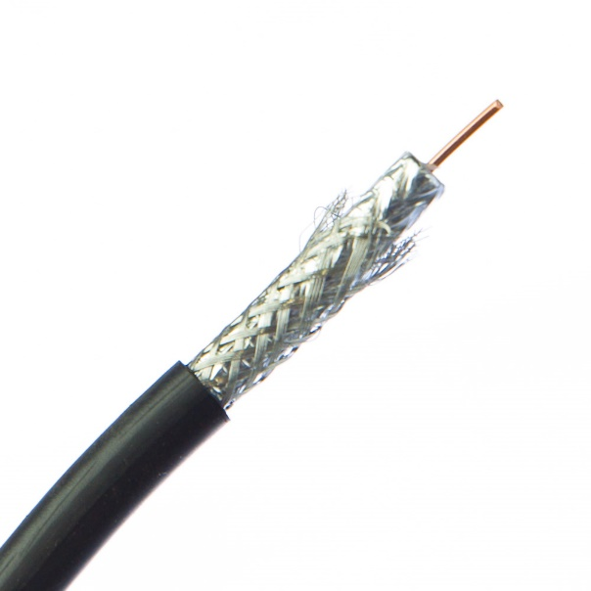
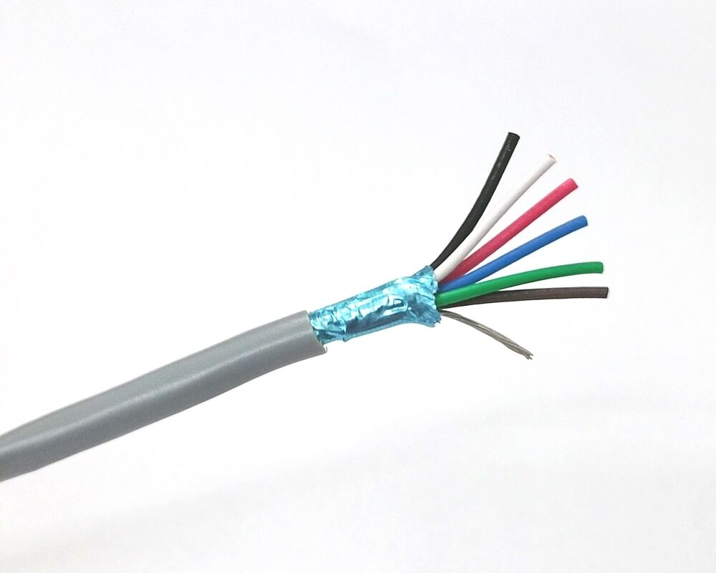
Run Some Interference Protection
  Reports of garbled, distorted, or unintelligible transmissions are symptoms of RF feedback in a transmitter or receiver. T7B11
  A common reason to use shielded wire is to prevent coupling of unwanted signals to or from the wire. T6D12
10

Slide 11
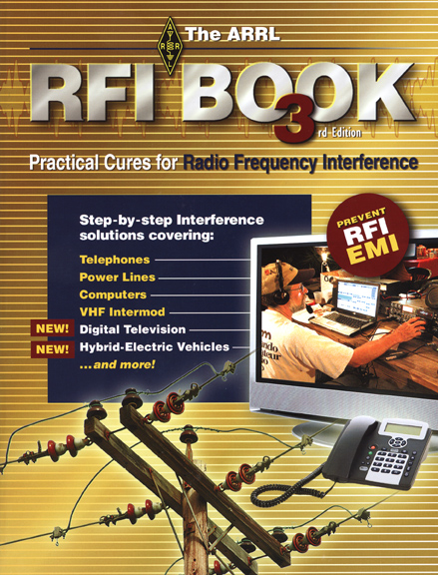
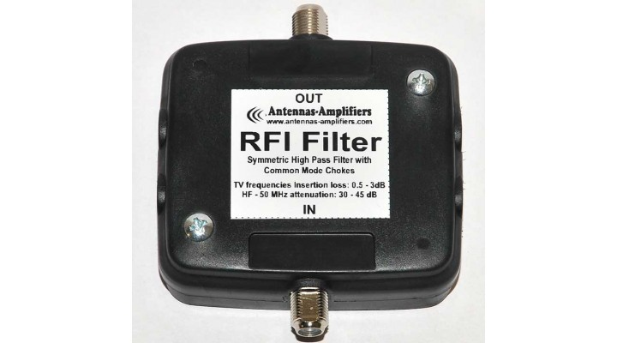
Run Some Interference Protection
  If a neighbor tells you that your station’s transmissions are interfering with their TV reception, make sure that your station is functioning properly and that it does not cause interference to your own radio or television when it is tuned to the same channel. T7B06
11

Slide 12
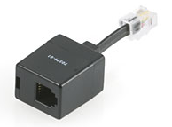
Run Some Interference Protection
  If a broadcast AM or FM radio receives an amateur radio transmission unintentionally, the receiver is unable to reject strong signals from outside the AM or FM band. T7B02
  To reduce or eliminate interference
  by an amateur transmitter to a
  nearby telephone, put a RF filter
  on the telephone. T7B04
12

Slide 13
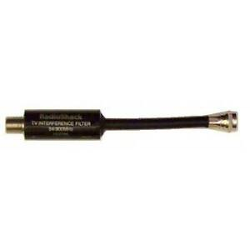
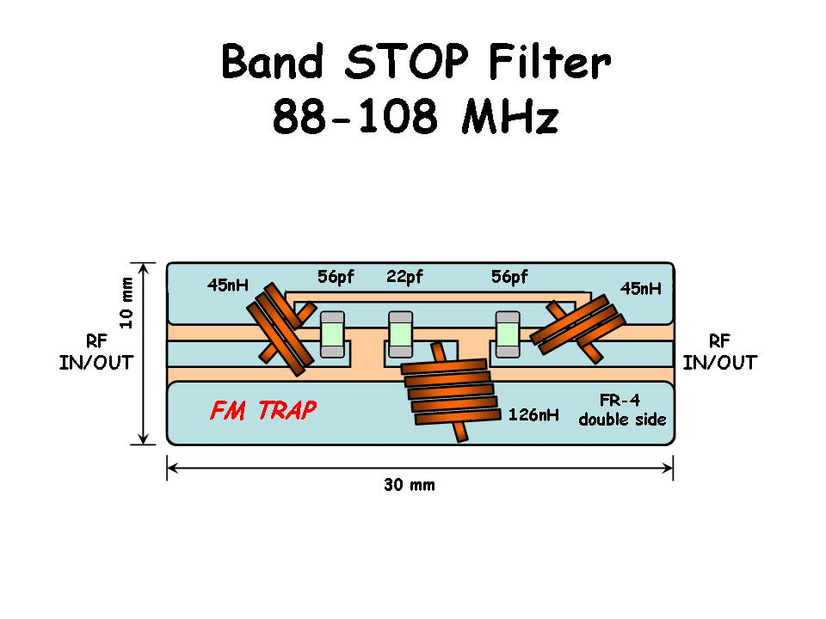
Run Some Interference Protection
  Overload of a non-amateur radio or TV receiver by an amateur signal can be reduced or eliminated by blocking the amateur signal with a filter at the antenna input of the affected receiver. T7B05
  A band reject filter can reduce overload to a VHF transceiver from a nearby FM station. T7B07
13

Slide 14
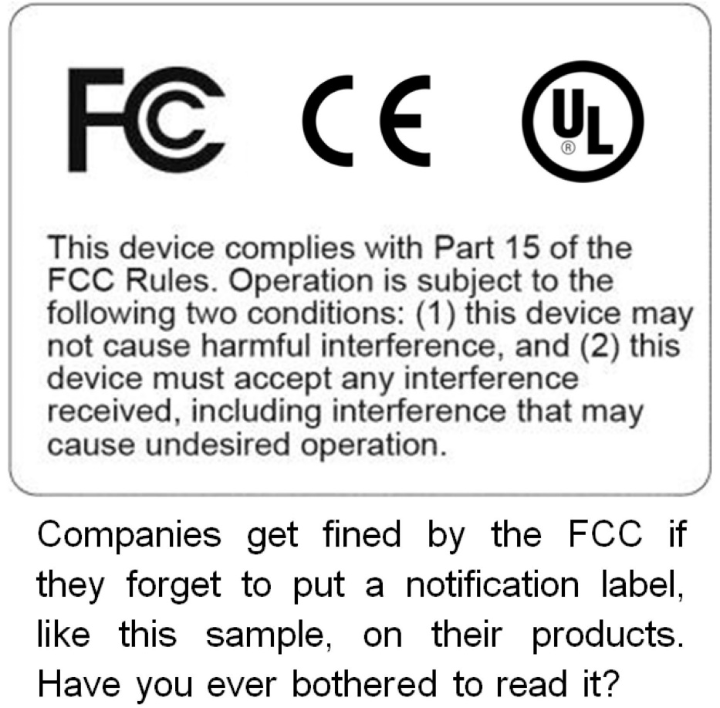
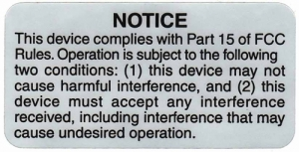
Run Some Interference Protection
  A Part 15 device is an unlicensed device that may emit low powered radio signals on frequencies used by a licensed service. T7B09
14

Slide 15
Run Some Interference Protection
  If something in a neighbor’s home is causing harmful interference to your amateur station:
    Work with your neighbor to identify the offending device;
    Politely inform your neighbor about the rules that prohibit the use of devices which cause interference;
    Check your station and make sure it meets the standards of good amateur practice;
        All these choices are correct. T7B08
15

Slide 16
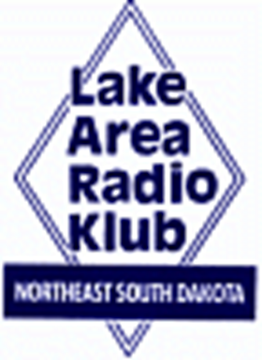

Element 2 Technician Class Question Pool
Run Some Interference Protection
Valid July 1, 2018
Through
June 30, 2022

Slide 17
T7B10 What might be a problem if you receive a report that your audio signal through the repeater is distorted or unintelligible?
  Your transmitter may be slightly off frequency
  Your batteries may be running low
  You could be in a bad location
  All of these choices are correct

Slide 18
T4B01 What may happen if a transmitter is operated with the microphone gain set too high?
  The output power might be too high
  The output signal might become distorted
  The frequency might vary
  The SWR might increase

Slide 19
T7B01 What can you do if you are told your FM handheld or mobile transceiver is over- deviating?
  Talk louder into the microphone
  Let the transceiver cool off
  Change to a higher power level
  Talk farther away from the microphone

Slide 20
T2B05 What might be the problem if a repeater user says your transmissions are breaking up on voice peaks?
You have the incorrect offset
You need to talk louder
You are talking too loudly
Your transmit power is too high

Slide 21
T4B05 Which of the following would reduce ignition interference to a receiver?
  Change frequency slightly
  Decrease the squelch setting
  Turn on the noise blanker
  Use the RIT control

Slide 22
T4B12 Which of the following could be used to remove power line noise or ignition noise?
  Squelch
  Noise blanker
  Notch filter
  All of these choices are correct

Slide 23
T4A10 What is the source of a high-pitched whine that varies with engine speed in a mobile transceiver’s receive audio?
  The ignition system
  The alternator
  The electric fuel pump
  Anti-lock braking system controllers

Slide 24
T4A12 What could be happening if another operator reports a variable high-pitched whine on the audio from your mobile transmitter?
  Your microphone is picking up noise from an open window
  You have the volume on your receiver set too high
  You need to adjust your squelch control
  Noise on the vehicle’s electrical system is being transmitted along with your speech audio

Slide 25
T4A09 Which of the following could you use to cure distorted audio caused by RF current flowing on the shield of a microphone cable?
  Band-pass filter
  Low-pass filter
  Preamplifier
  Ferrite choke

Slide 26
T7B12 What should be the first step to resolve cable TV interference from your ham radio transmission?
  Add a low pass filter to the TV antenna input
  Add a high pass filter to the TV antenna input
  Add a preamplifier to the TV antenna input
  Be sure all TV coaxial connectors are installed properly

Slide 27
T7B03 Which of the following can cause of radio frequency interference?
  Fundamental overload
  Harmonics
  Spurious emissions
  All of these choices are correct

Slide 28
T7B11 What is a symptom of RF feedback in a transmitter or transceiver?
  Excessive SWR at the antenna connection
  The transmitter will not stay on the desired frequency
  Reports of garbled, distorted, or unintelligible transmissions
  Frequent blowing of power supply fuses

Slide 29
T6D12 Which of the following is a common reason to use shielded wire?
  To decrease the resistance of DC power connections
  To increase the current carrying capability of the wire
  To prevent coupling of unwanted signals to or from the wire
  To couple the wire to other signals

Slide 30
T7B06 Which of the following actions should you take if a neighbor tells you that your station’s transmissions are interfering with their radio or TV reception?
  Make sure that your station is functioning properly and that it does not cause interference to your own radio or television when it is tuned to the same channel
  Immediately turn off your transmitter and contact the nearest FCC office for assistance
  Tell them that your license gives you the right to transmit and nothing can be done to reduce the interference
  Install a harmonic doubler on the output of your transmitter and tune it until the interference is eliminated

Slide 31
T7B02 What would cause a broadcast AM or FM radio to receive an amateur radio transmission unintentionally?
  The receiver is unable to reject strong signals outside the AM or FM band
  The microphone gain of the transmitter is turned up too high
  The audio amplifier of the transmitter is overloaded
  The deviation of an FM transmitter is set too low

Slide 32
T7B04 Which of the following is a way to reduce or eliminate interference by an amateur transmitter to a nearby telephone?
  Put a filter on the amateur transmitter
  Reduce the microphone gain
  Reduce the SWR on the transmitter transmission line
  Put an RF filter on the telephone

Slide 33
T7B05 How can overload of a non-amateur radio or TV receiver by an amateur signal be reduced or eliminated?
  Block the amateur signal with a filter at the antenna input of the affected receiver
  Block the interfering signal with a filter on the amateur transmitter
  Switch the transmitter from FM to SSB
  Switch the transmitter to a narrow-band mode

Slide 34
T7B07 Which of the following can reduce overload to a VHF transceiver from a nearby FM broadcast station?
  RF preamplifier
  Double-shielded coaxial cable
  Using headphones instead of the speaker
  Band-reject filter

Slide 35
T7B09 What is a Part 15 device?
  An unlicensed device that may emit low powered radio signals on frequencies used by a licensed service
  A type of amateur radio that can legally be used in the citizen’s band
  A device for long distance communications using special codes sanctioned by the International Amateur Radio Union
  A type of test set used to determine whether a transmitter is in compliance with FCC regulation 91.15

Slide 36
T7B08 What should you do if something in a neighbor’s home is causing harmful interference to your amateur station?
  Work with your neighbor to identify the offending device
  Politely inform your neighbor about the rules that prohibit the use of devices which cause interference
  Check your station and make sure it meets the standards of good amateur practice
  All of these choices are correct

